Slide 1
ASTERICS
Connecting multi-messenger astrophysics
Giuseppe Cimò
Joint Institute for VLBI - ERIC (JIVE)
Netherlands Institute for Radio Astronomy (ASTRON)
Notes:
Acknowledge Mike

Slide 2
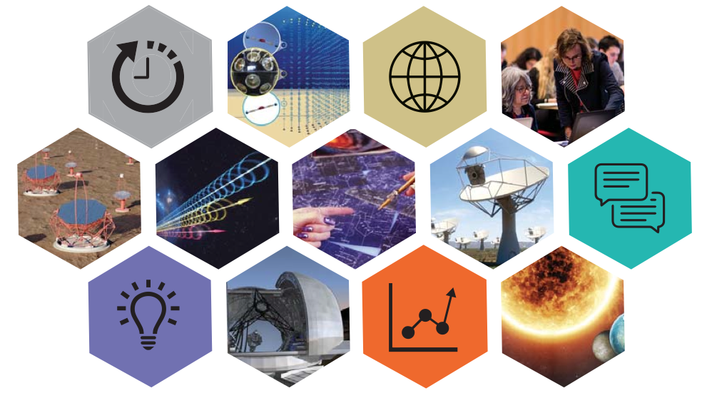
what is ASTERICS?
Astronomy ESFRI & Research Infrastructure Cluster
A major collaboration (23 partner institutions) in astronomy, astrophysics and astroparticle physics.
It is funded by EC Horizon 2020 framework at € 15M for 4 years
(2015-2019)
  Scope of ASTERICS:
  To help solve the Big Data challenges of European astronomy
  To provide direct interactive access to the best European astronomy data in an international framework
  Cross-cutting synergies and common challenges

Slide 3

concept and approach
  Supporting the European Strategy Forum on Research Infrastructures (ESFRI)
Notes:
LSST: Large Synoptic Survey Telescope under construction in Chile. Survey the dynamic universe
Euclid: Space telescope for dark energy

Slide 4
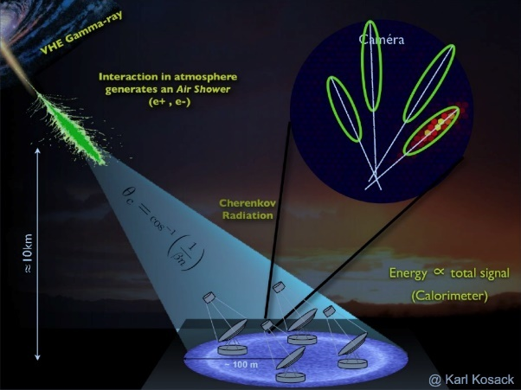
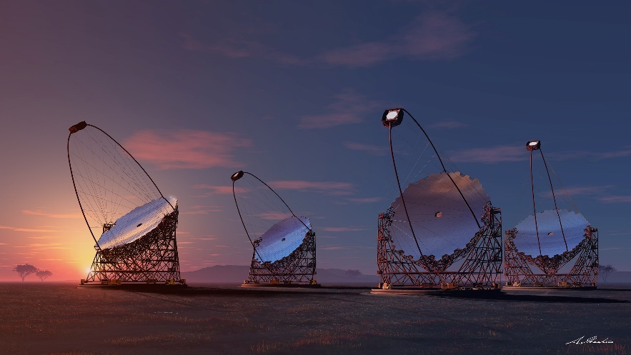
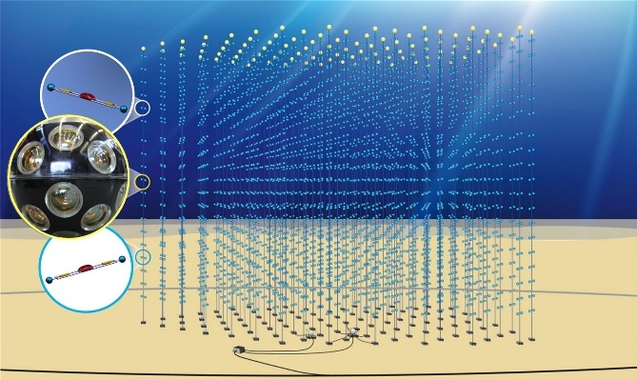
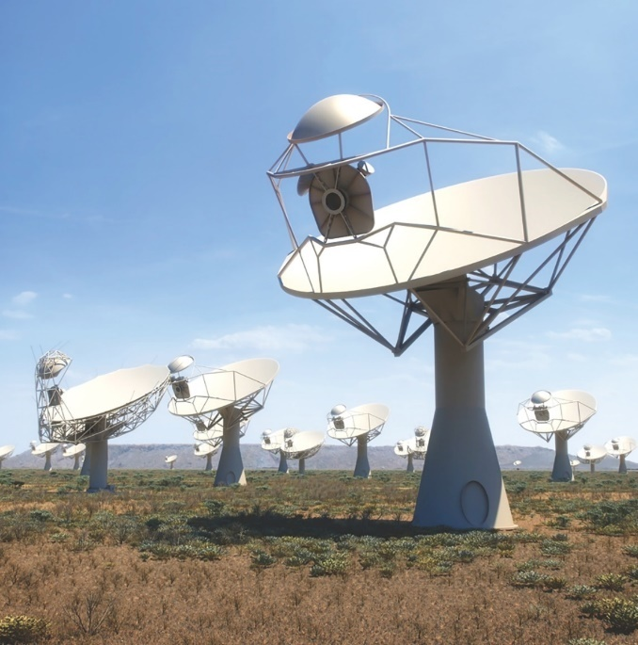

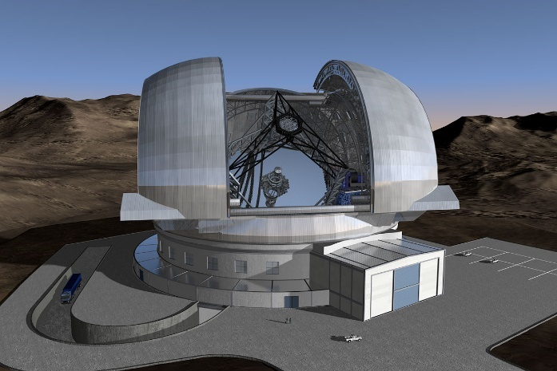
Very high energy 𝜸-ray observatory
Two arrays of 100 (N) and 20 (S) telescopes
Event re-construction
Complex metadata
Streaming and processing challenges
Precursors: MAGIC and HESS
A multi-km³ neutrino telescope
Exploring our galaxy for high energy neutrino sources
KM3Net2 on timescale of 2020
General purpose optical/infrared telescope
high redshift galaxies
star formation
exoplanets
protoplanetary systems
SKA-LOW, Australia
Phase 1: 130,000 dipoles over 80 km
Phase 2: 500,000 dipoles over 250 km
SKA-MID, South Africa
Phase 1: 200 dishes over 150 km
Phase 2: 2500 dishes over 3500 km
Phase 1 (2018-2023)
Phase 2 (2025-2033)
Challenges everything…
E-ELT
39m European-Extremely Large Telescope First Light targeted for late 2024

Slide 5
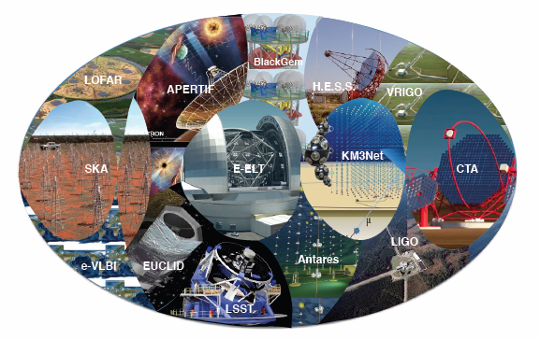
concept and approach
  Supporting the European Strategy Forum on Research Infrastructures (ESFRI)
Aspiring ESFRI projects + pathfinders
Other world-class research infrastructures
  e.g. LOFAR, Euclid, LSST, Virgo
Together, the ESFRI projects – and their pathfinders – open new windows on the universe, significantly extending our observational capabilities across the electromagnetic spectrum, in addition to neutrino detectors and gravitational waves
Notes:
LSST: Large Synoptic Survey Telescope under construction in Chile. Survey the dynamic universe
Euclid: Space telescope for dark energy

Slide 6
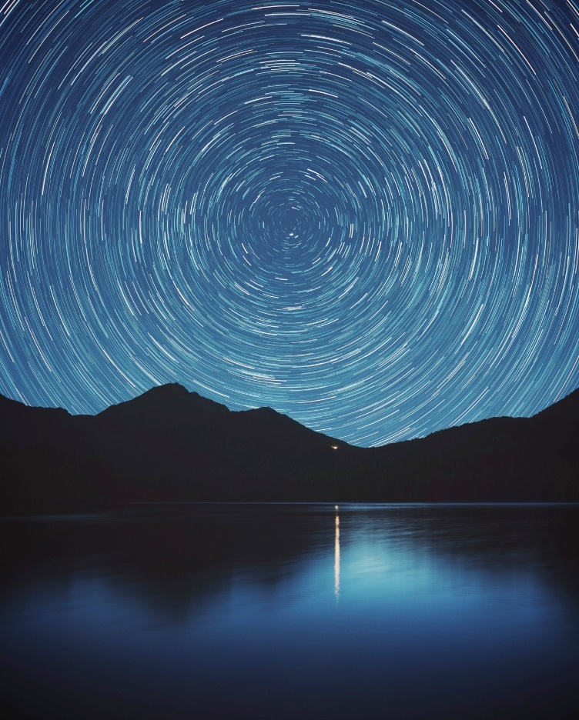
addressing common challenges in astronomy and astroparticle physics
supporting and accelerating the implementation of a new generation of observatories
enhancing performance
helping scientists to access data
  ESFRIs interoperating as an integrated multi-λ, multi-messenger facility

Slide 7
multi-λ, multi-messenger
messengers: photons, 𝝂, gravitational waves, VHE𝜸
multi-λ:
  transient source astronomy
To make it happen…
Cooperation, Interoperability, Open Data
Scalability – processing and analysis
Big Data, Data mining, Data Access
Streaming and timing

Slide 8
connections & openness
connecting infrastructures: enhancing individual capabilities - necessary for science!
  ICT: high speed data transport/timing
Embracing Open Science, Open Access, Open Data
  improve knowledge circulation
  many challenges, many opportunities
Engage with society at large
  Astro community, education, public

Slide 9
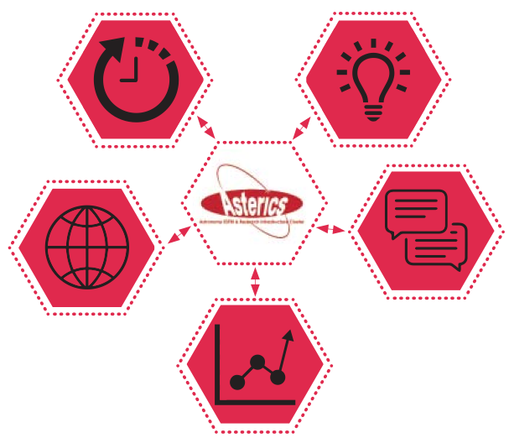
CLEOPATRA: Connecting Locations of ESFRI Observatories and Partners in Astronomy for Timing
and Real time Alerts)
Management
DECS: Disseminaton, Engagement and Citizen Science
DADI : Data Access, Discovery and Interoperability
OBELICS: OBservatory E-environments LInked by common ChallengeS

Slide 10
Challenges
Big Data
Data Access
Multi-Messenger
Open Science
Parallel software programming techniques, to adopt big-data software frameworks, to benefit from new processor architectures and e-science infrastructures.
Software re-use and co-development of technology
Adapt and optimise extremely large database systems
Virtual Observatory and VOEvents
Cooperation with the ESFRI pathfinders, computing centres, e-infrastructure providers and industry
Public engagement and Citizen Science

Slide 11
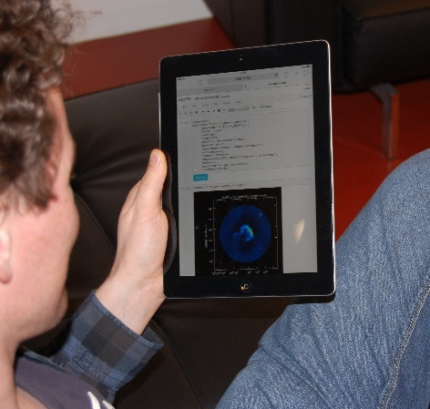
Evolution of storage needs and computing needs for the ESFRI Projects
Innovative application of the docker container
Jupyter notebook of the CASA 3C391 VLA continuum tutorial running inside a web browser on a tablet
Evolution of storage needs for the ESFRI Projects
Lossless compression algorithm produced for astro(particle) experiments.
Now under discussion and tests in more ESFRI scenarios.
Libraries for fast, vectorised, array reductions and moment calculations written in C++ with Python binding, potentially have an impact outside of astronomy since they implement fairly generic operations
Notes:
In the best case scenario, these will be adopted by the ESFRI projects.
In most of the cases, these results have triggered discussions within
collaborations and therefore improved the current development of the
ESFRI projects.

Slide 12
Big Data
Low power architectures benchmarking for building innovative computing, storage and data handling platforms.
Optimisation and parallelization of algorithms for data reduction and analysis in order to exploit the low-power computing facilities
Development of high performance computing solution
Notebook interface (VLBI in the Cloud) can be of use for all radio interferometric data analysis
General-purpose library of A&A and workflow management systems
Contribution to define specifications in an open data format within the gamma-ray community
Data streaming and architecture of the data processing unit in SKA
Exploitation of LPC architectures for map/reduce applications.
Notes:
A&A: Work on interoperability between clouds (EGI-ComputeCanada) based on an IVOA standard (VOSpace) led to the agreement on an IVOA Authorization standard proposal

Slide 13
Data Access
Virtual Observatory
The VO can be seen as a kind of club of data services that all follow the same rules.
International Virtual Observatory Alliance
IVOA standards
Interface between domain-specific & generic infrastructure
New and archive data
DADI technology Forum | 17-18 Sept 2015, Strasbourg
ASTERICS European Schools open call to European Astronomers (PhD, Post-doc) 50 participants | Dec 2015
ESFRI Forum and training event network, share lessons learnt, discuss requirements, training | Dec 2015
Data provider Forum open to all European Data providers | Nov 2016, Heidelberg

Slide 14
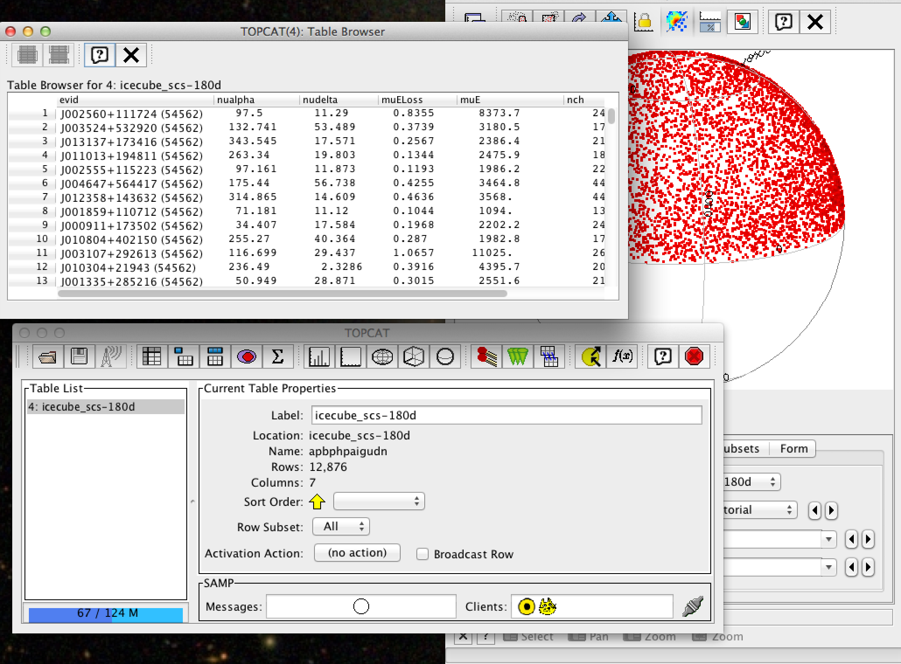
Virtual Observatory
view
table
sky plot
Visualisation with VO tools
IceCube-40 String data
12,877 candidate neutrino events
Event list managed using the Topcat VO tool
http://www.star.bris.ac.uk/~mbt/topcat/
Visualisation through the Aladin VO portal
http://aladin.u-strasbg.fr/aladin.gml
database
loaded into
Topcat

Slide 15
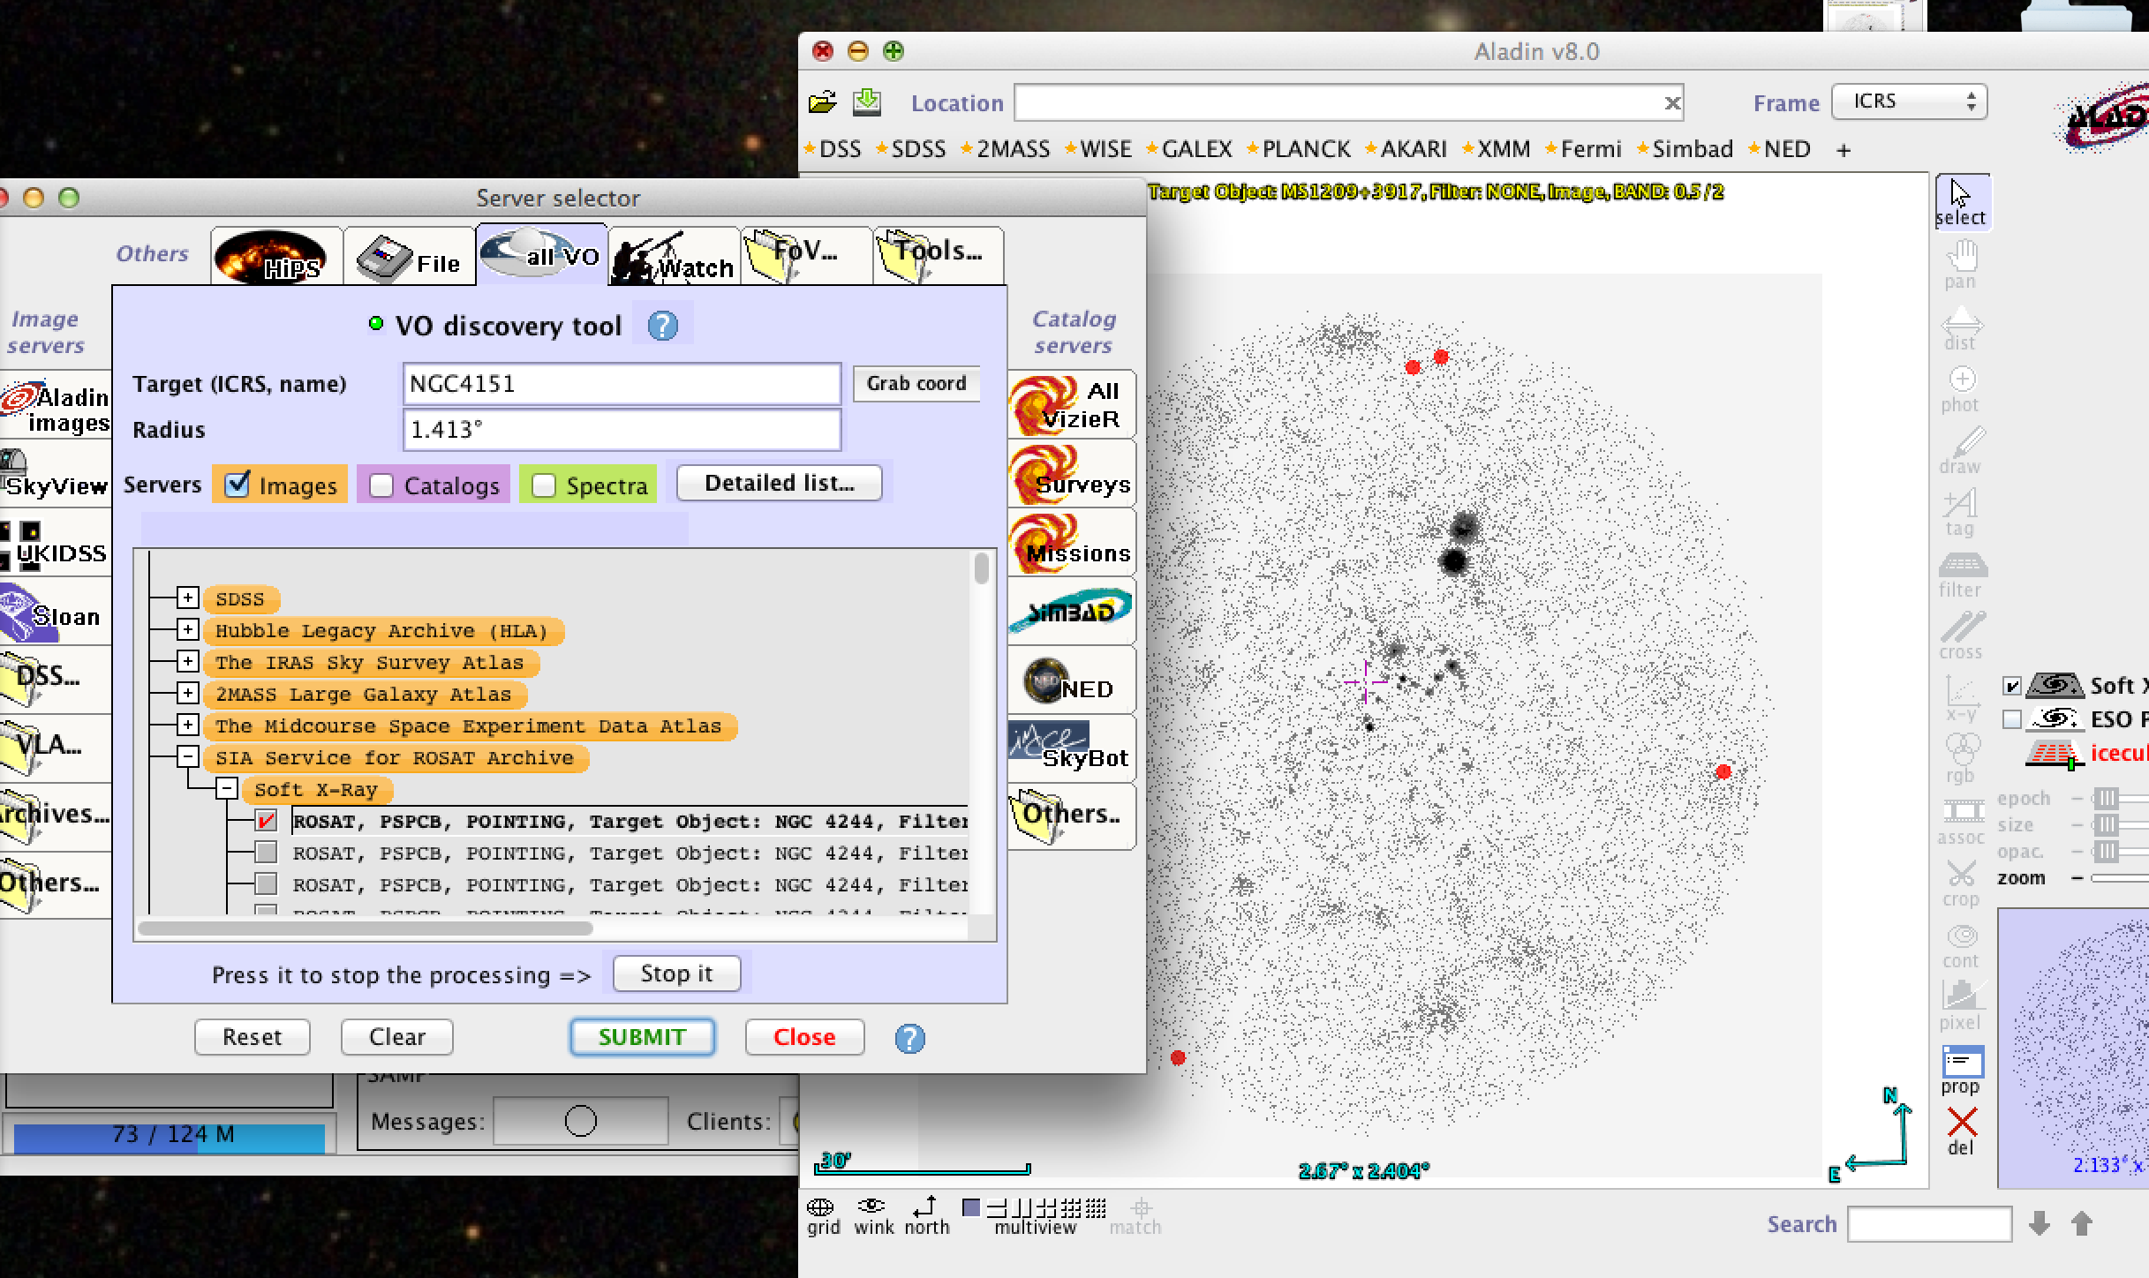
Virtual Observatory
show neutrino events
overlaid on X-ray image
In Aladin, search for
images of NGC 4151
pick this ROSAT image

Slide 16
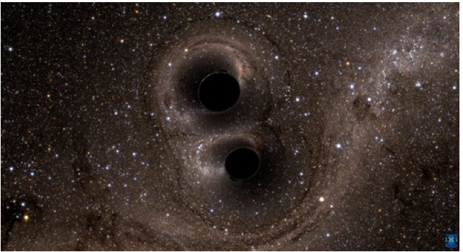
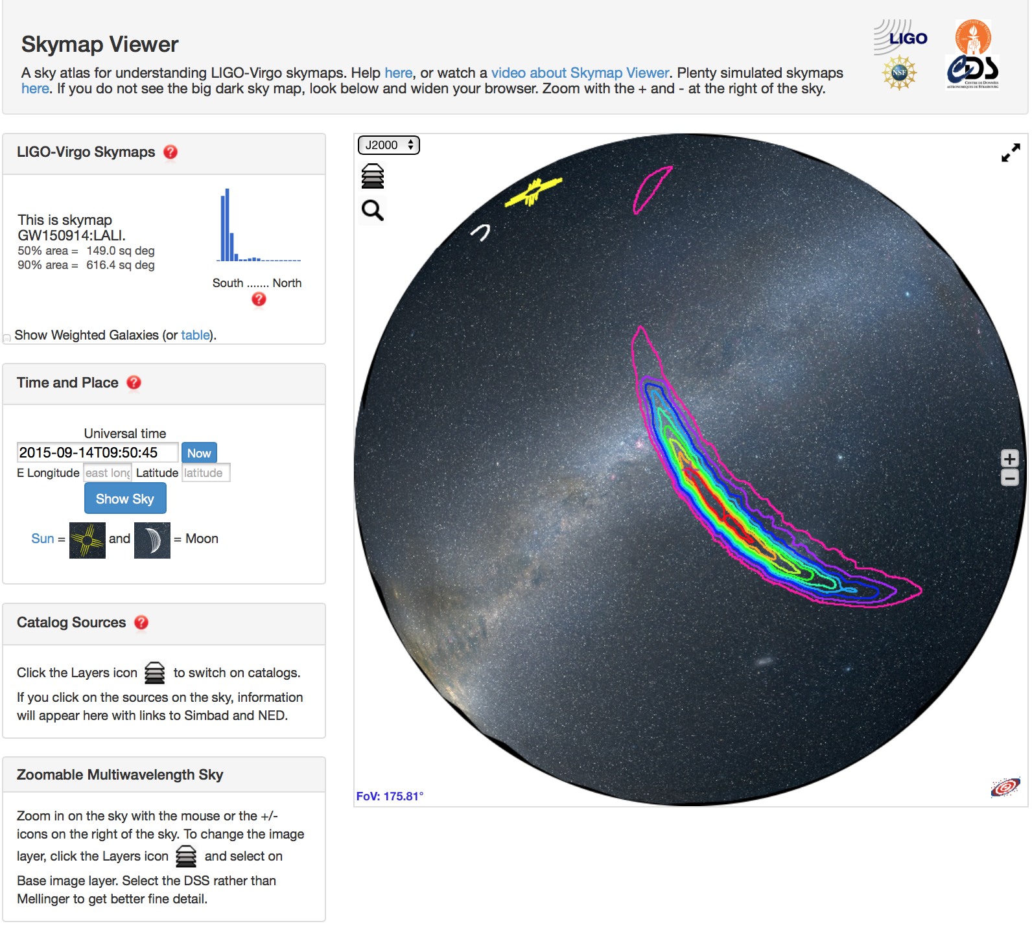
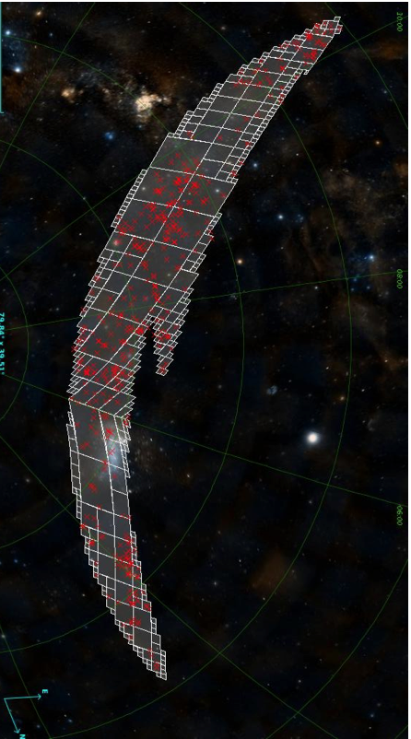
ASTERICS connections: gravitational waves
ASTERICS fostered use of VO for grav wave EM follow-up

Slide 17
Multi-Messenger
Challenges
• Develop standards for generation, dissemination,
distribution and reaction to transient events (based
on VOEvents)
• Demonstration:
LOFAR, EVN, follow up a GW event
• Investigate scientific synergies for automated followup observations

Slide 18
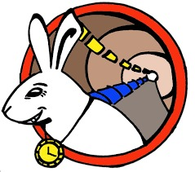
multi-messenger timing and synchronisation
Connecting real facilities now as path to connected future facilities
Building on success of e-VLBI
EXPReS, NEXPReS
…here comes the White Rabbit

Slide 19
White Rabbit Ethernet (CERN, based on IEEE Precision Time Protocol)
• ASTERICS made real impact in WR community
– Improvements are fed back → open source
• Generated serious outside interest
• Fed into tender for new photonic equipment for SURFnet
• WR timing in design of SKA-low
– Frequency stability now good enough for frequency transfer
• Commercial applications under development
• Time, frequency, and 1 Gb/s data in one
• 1 PPS, 10 – 125 MHz
• Designed for 1 ns timing
over distances <10 km (LHC, CERN)
• Commercially available

Slide 20
Scheduling of large astronomical infrastructures
• Complex, many-element detector arrays
• Artificial Intelligence (AI) techniques to optimize procedures
– Metaheuristic Optimization: Genetic Algorithms, Multi-objective Evolutionary Algorithms
– Constraint-Based Reasoning: constraint propagation
• Maximize science return of SKA and CTA
– But ensure solutions are applicable for other instruments
• Incorporate multi-frequency, multi-messenger astrophysics
• Provide a framework to coordinate and schedule multiple facilities.

Slide 21
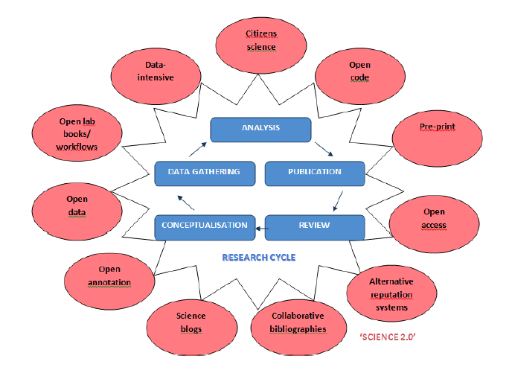
Open Science
Open ESFRI facilities to wider stakeholders through citizen science (Open Science, or ‘Science 2.0’)
Audiences: scientific & technical communities, academia, private industry, other public research centres, SMEs, policy makers, general public
Coordinated citizen science experiments to open ESFRIs & pathfinders/precursors to public
Educational resources & efficacy metrics
Citizen Science is not outreach!
Notes:
The usual role of the outreach work package is just dissemination of information, but we want to do something far better. ASTERICS aims to use the best open science practice – not just in open access scientific publications and open access to data through the virtual observatory, but by direct engagement of the public in the process of what computer science people call ‘knowledge discovery’. We’re using citizen science, mass participation experiments. The important thing to remember is that citizen science is NOT outreach. It’s a tool for doing an experiment, like a spectrometer. You’re applying thousands or tens of thousands human brains on an algorithmically-complex classification problem.

Slide 22
Citizen Science
Pulsar Hunters ++
CREDO
Cosmic Ray Extremely Distributed Observatory
Lead: Rene Breton
Science goal: Extend the successful Pulsar Hunters Zooniverse project to harder-to-find pulsars
Activity: interactive data visualization of pulsar time and frequency domain data; future application to SKA
Lead: Piotr Homola https://credo.ifj.edu.pl/
Science objective: detect
ultra-high-energy charged particles with a whole-Earth Cherenkov detector
Activity: use mobile phones as charged particle detectors

Slide 23
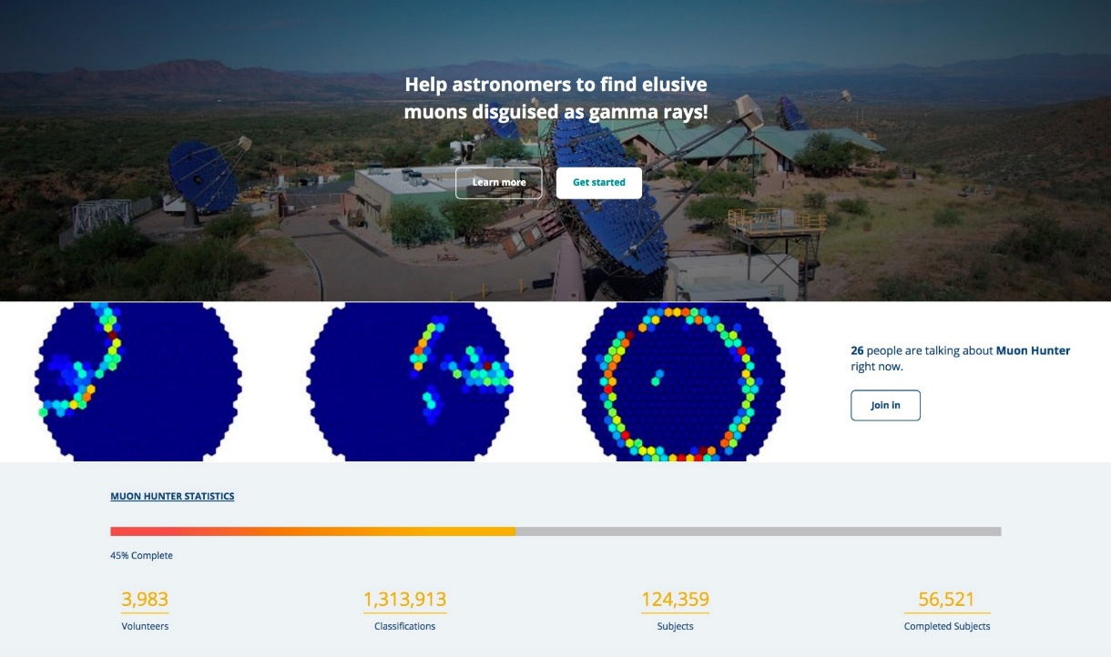
Citizen Science
Muon Hunters
Lead: Lucy Forston, CTA
Science goal: detect fainter Cherenkov events by visual classification
Activity: classify hadron vs. photon events in the CTA telescopes, morphologically and in the time domain; apply first to simulations and to e.g. HESS
1.3 million classifications in the first five days!
Notes:
STRESS THAT LUCY INVITED AS CTA REPRESENTATIVE AND THAT EXPLICIT INTENTION IS TO BUILD EXPERIMENT THAT WORKS ON PATHFINDER DATA AND WILL BE APPLIED LATER ON FULL ESFRI DATA

Slide 24
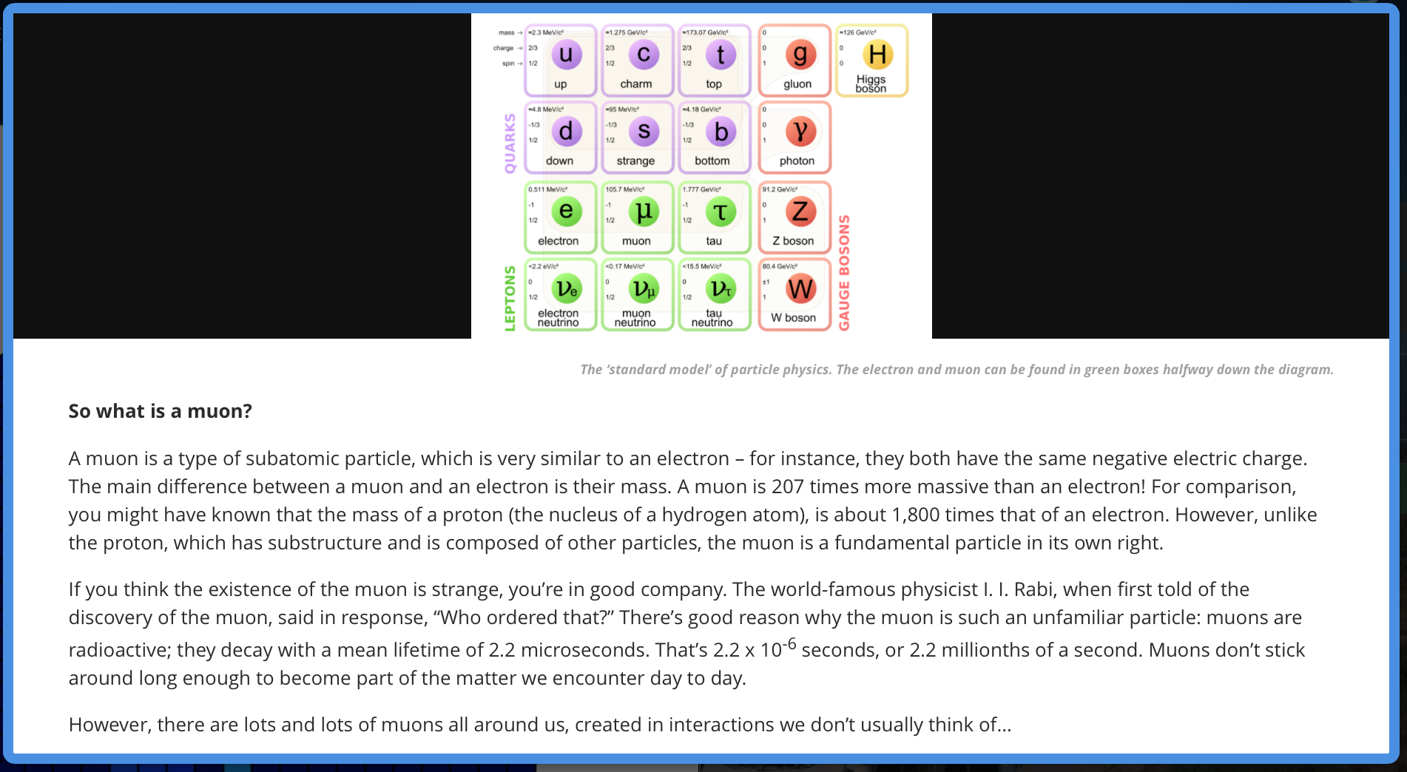
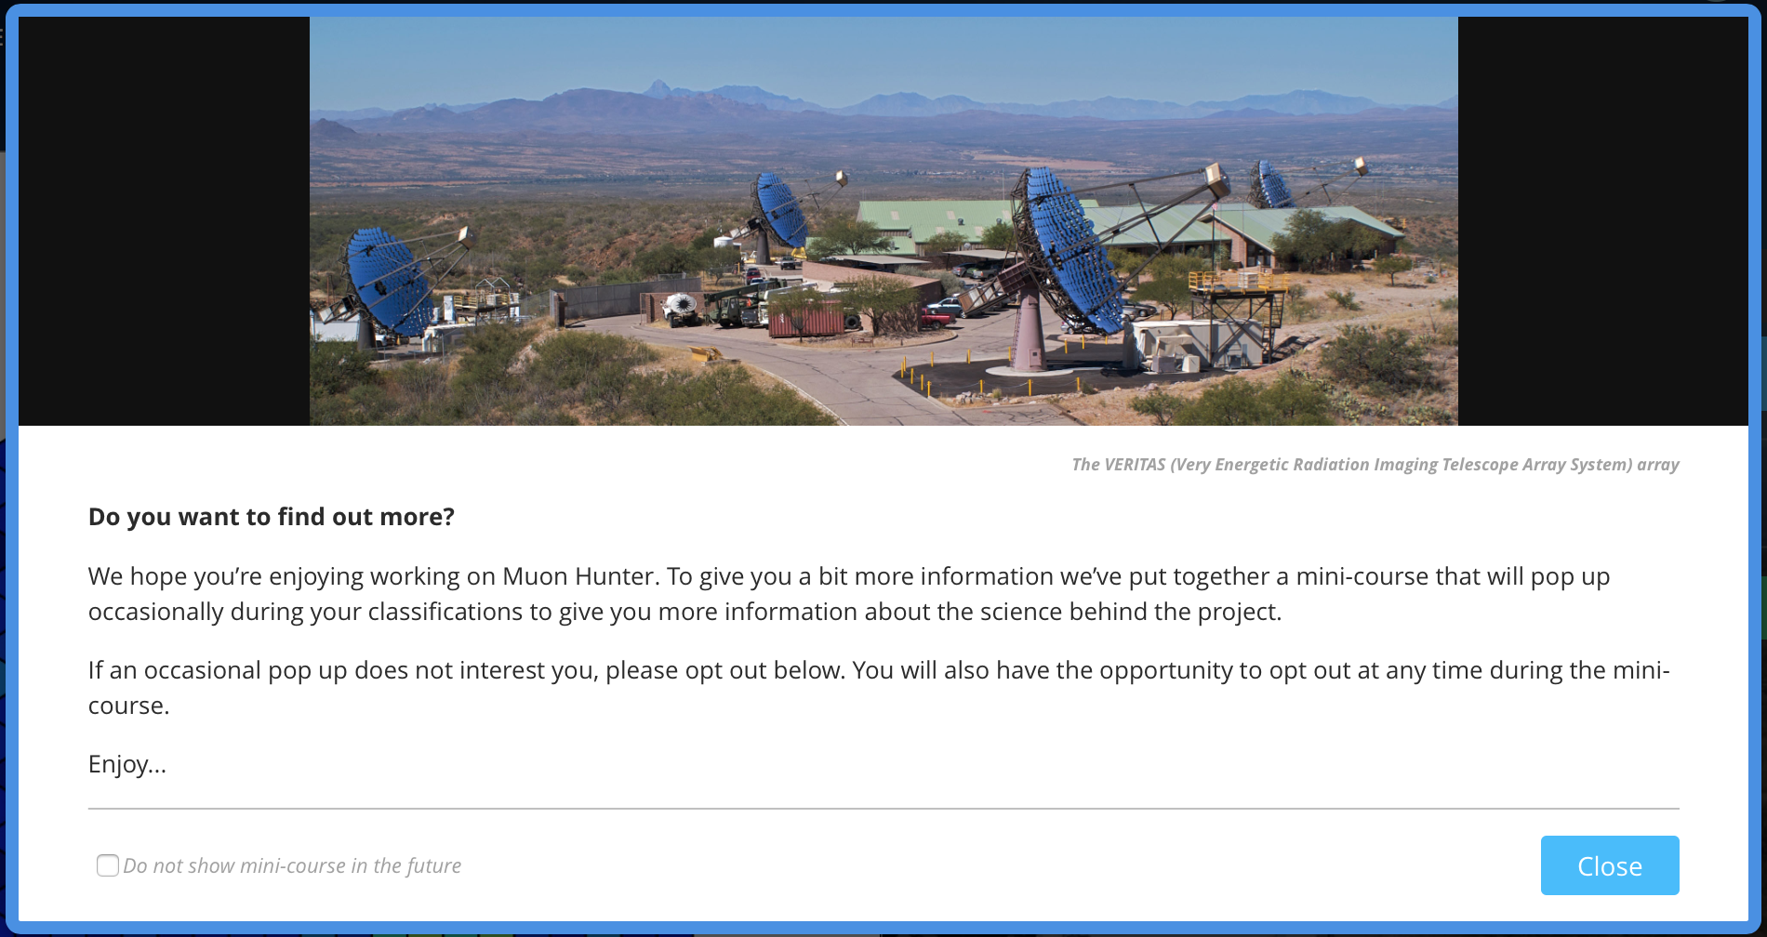
Notes:
EDUCATIONAL RESOURCES DELIBERATELY DESIGNED TO BE EMBEDDED WITHIN CITIZEN SCIENCE EXPERIMENT

Slide 25

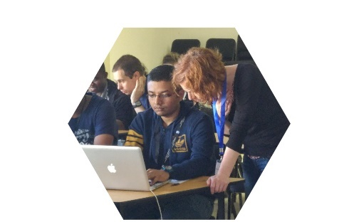

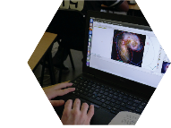
Strengths from connections
Enabling data science
  Training and support
  Skill sets for astronomy

Slide 26
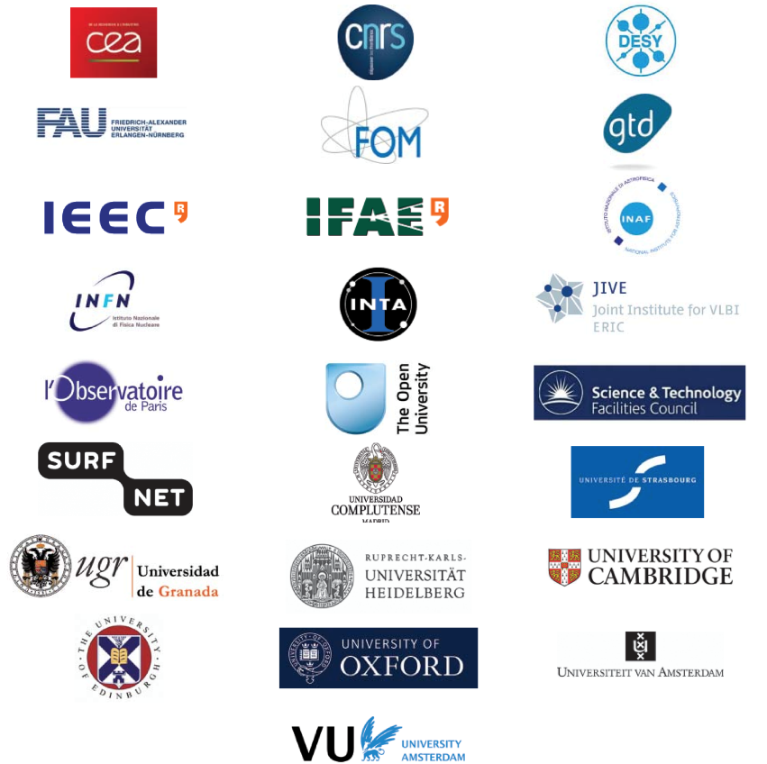
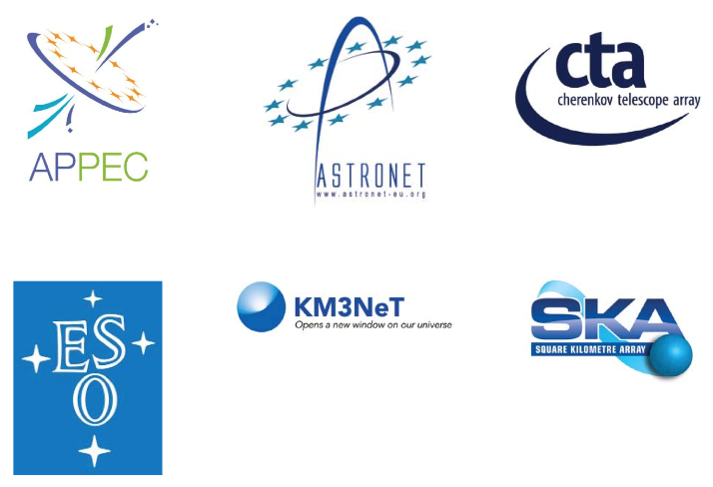

Participating institutions
Supporting organisations and networks

