Slide 1
Connecting multi-messenger astrophysics R&D in ASTERICS and nanosecond timing in normal life
Mark Allen¹
followed by Peter Jansweijer²
¹Observatoire astronomique de Strasbourg, Université de Strasbourg, CNRS, FRANCE
²Nikhef, Amsterdam

Slide 2
Astronomy ESFRI & Research Infrastructure Cluster

Slide 3
what is ASTERICS?
A €15 million Research Infrastructure funded by EC Horizon 2020 framework (2015-2019)
To help solve the Big Data challenges of European astronomy
To provide direct interactive access to the best European astronomy data in an international framework
Cross-cutting synergies and common challenges

Slide 4
addressing common challenges in astronomy and astroparticle physics
supporting and accelerating the implementation of a new generation of observatories
enhancing performance
helping scientists to access data
ESFRIs+ interoperating as an integrated multi-λ, multi-messenger facility

Slide 5
concept and approach
Supporting the European Strategy Forum on Research Infrastructures (ESFRI)
Aspiring ESFRI projects + pathfinders
Other world-class research infrastructures
e.g. LOFAR, Euclid, LSST, Virgo

Slide 6
multi-λ, multi-messenger
messengers: photons, 𝝂, grav. waves, VHE𝜸
multi-λ:
transient source astronomy
To make it happen…
Interoperability, cooperation, Open Data
Scalability – processing and analysis
Big Data, Data mining,
Streaming and timing

Slide 7
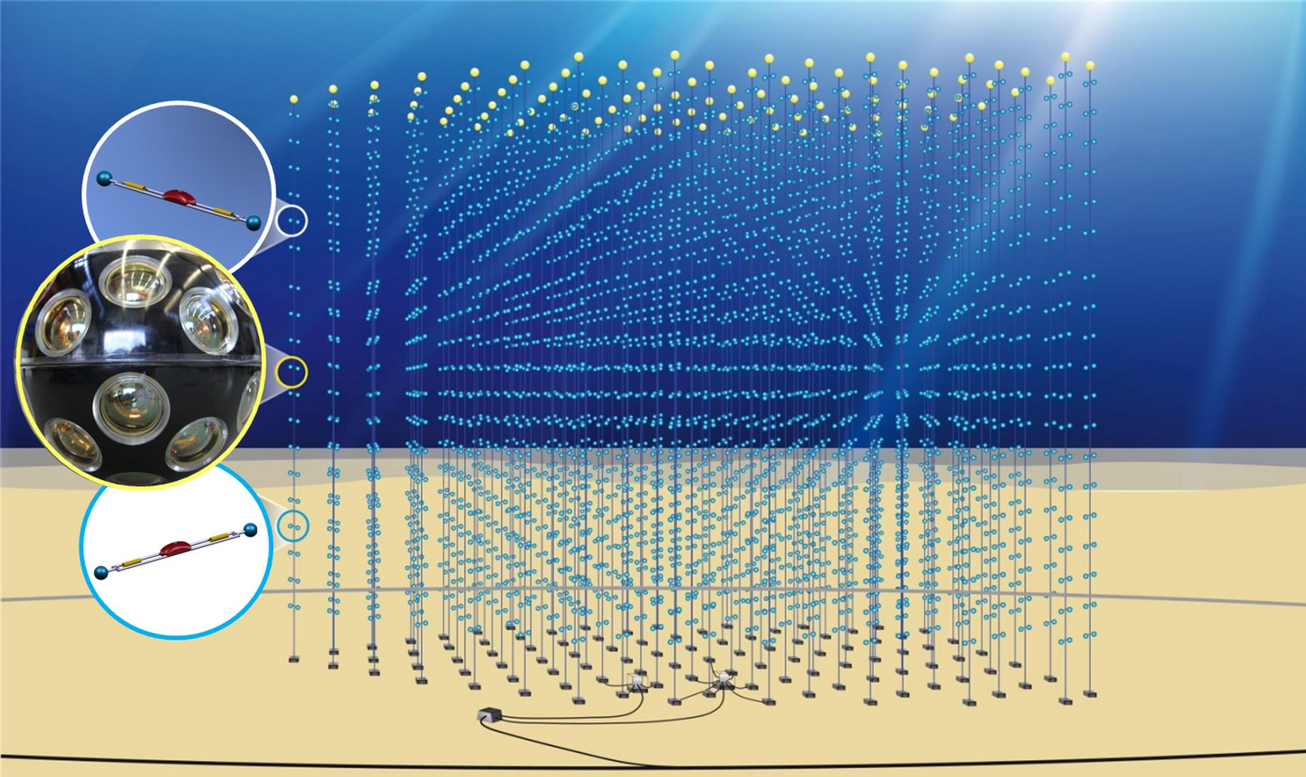
KM3NeT
A multi-km³ neutrino telescope
Exploring our galaxy for high energy neutrino sources
KM3Net2 on timescale of 2020

Slide 8
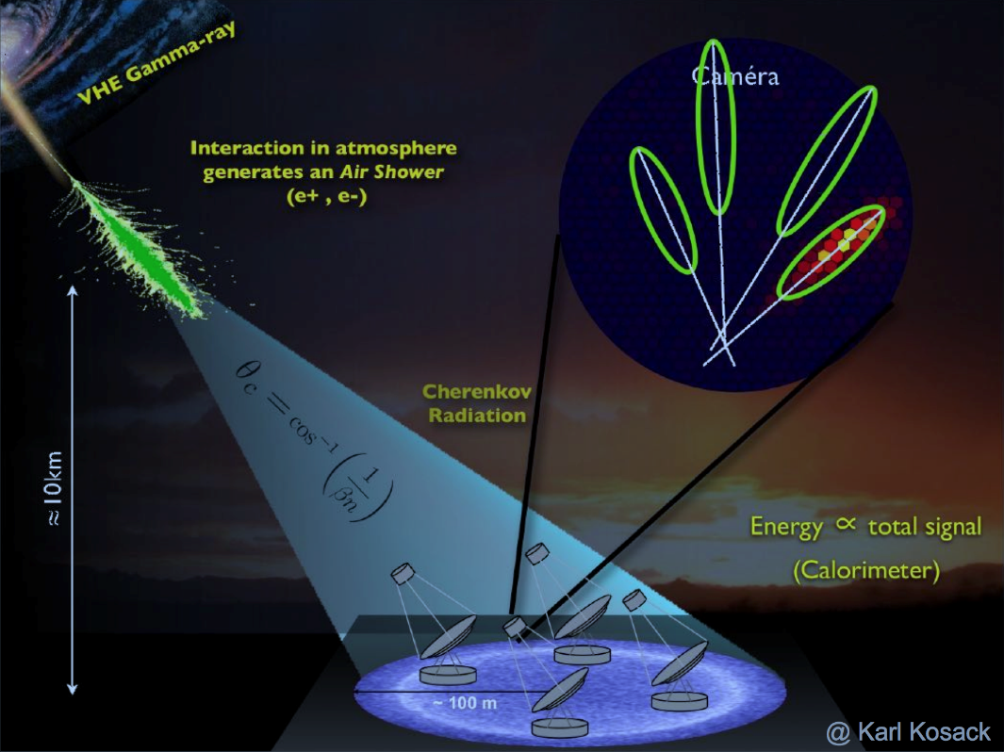
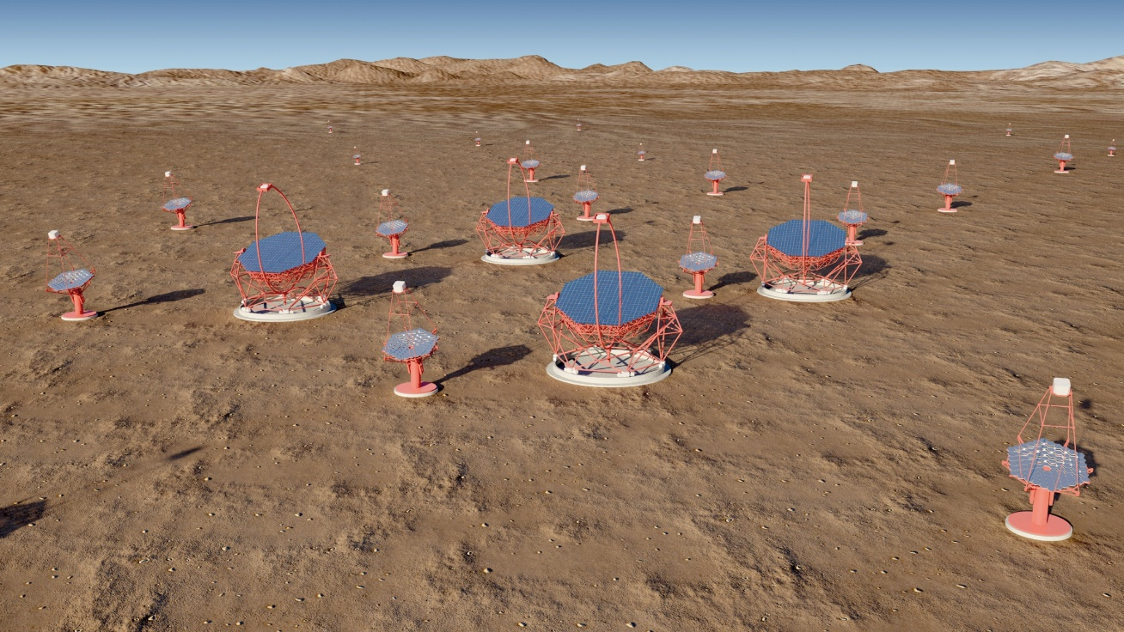
CTA
- Very high energy 𝜸-ray observatory
- Two arrays of 100 (N) and 20 (S) telescopes
- Event re-construction
- Complex metadata
- Streaming and processing challenges
- Precursors: MAGIC and HESS
￼
Production phase 2018-2023

Slide 10
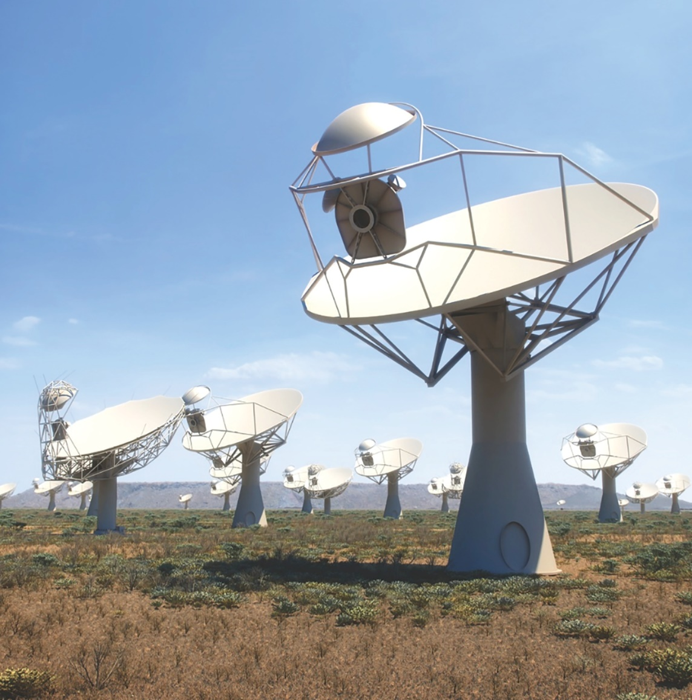
SKA
SKA-LOW, Australia
Phase 1: 130,000 dipoles over 80 km
Phase 2: 500,000 dipoles over 250 km
SKA-MID, South Africa
Phase 1: 200 dishes over 150 km
Phase 2: 2500 dishes over 3500 km
Phase 1 (2018-2023)
Phase 2 (2025-2033)
Challenges everything…

Slide 11
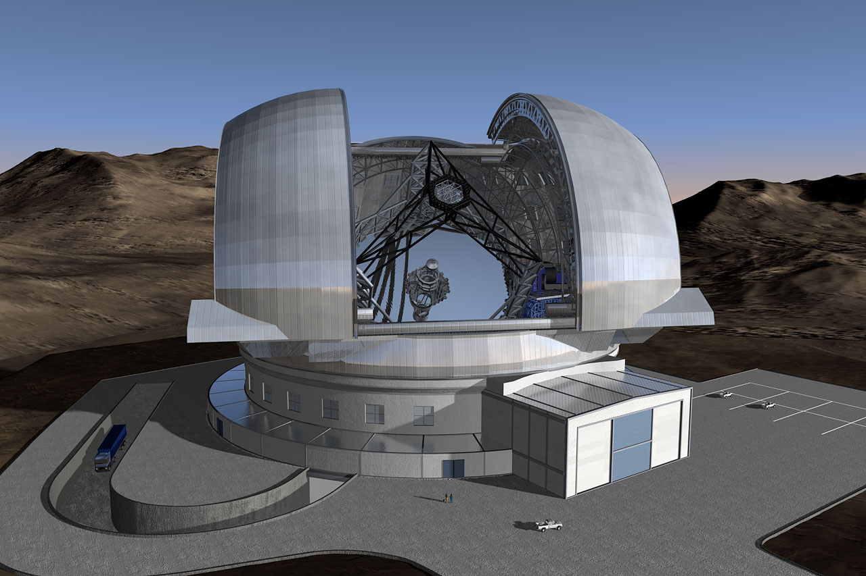
E-ELT
General purpose optical/infrared telescope
Several scientific instruments (fast switching)
Science areas include:
high redshift galaxies
star formation
exoplanets
protoplanetary systems
39m European-Extremely Large Telescope First Light targeted for late 2024

Slide 12
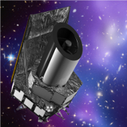
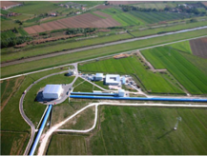
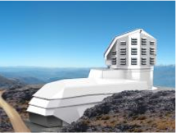
World class facilities and ESFRI pathfinders
Connecting real facilities now as path to connected future facilities
Euclid
EGO/Virgo

Slide 13
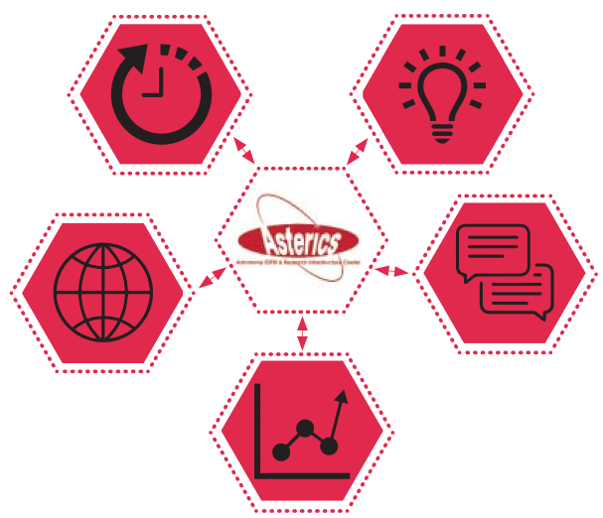
CLEOPATRA: Connecting Locations of ESFRI Observatories and Partners in Astronomy for Timing
and Real time Alerts)
Management
DECS: Disseminaton, Engagement and Citizen Science
DADI : Data Access, Discovery and Interoperability
OBELICS: OBservatory E-environments LInked by common ChallengeS

Slide 14
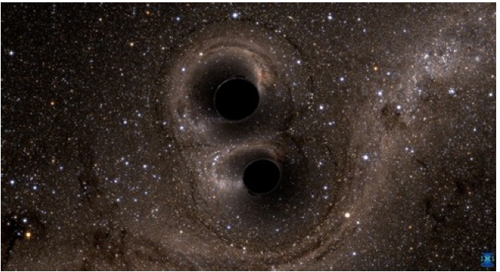
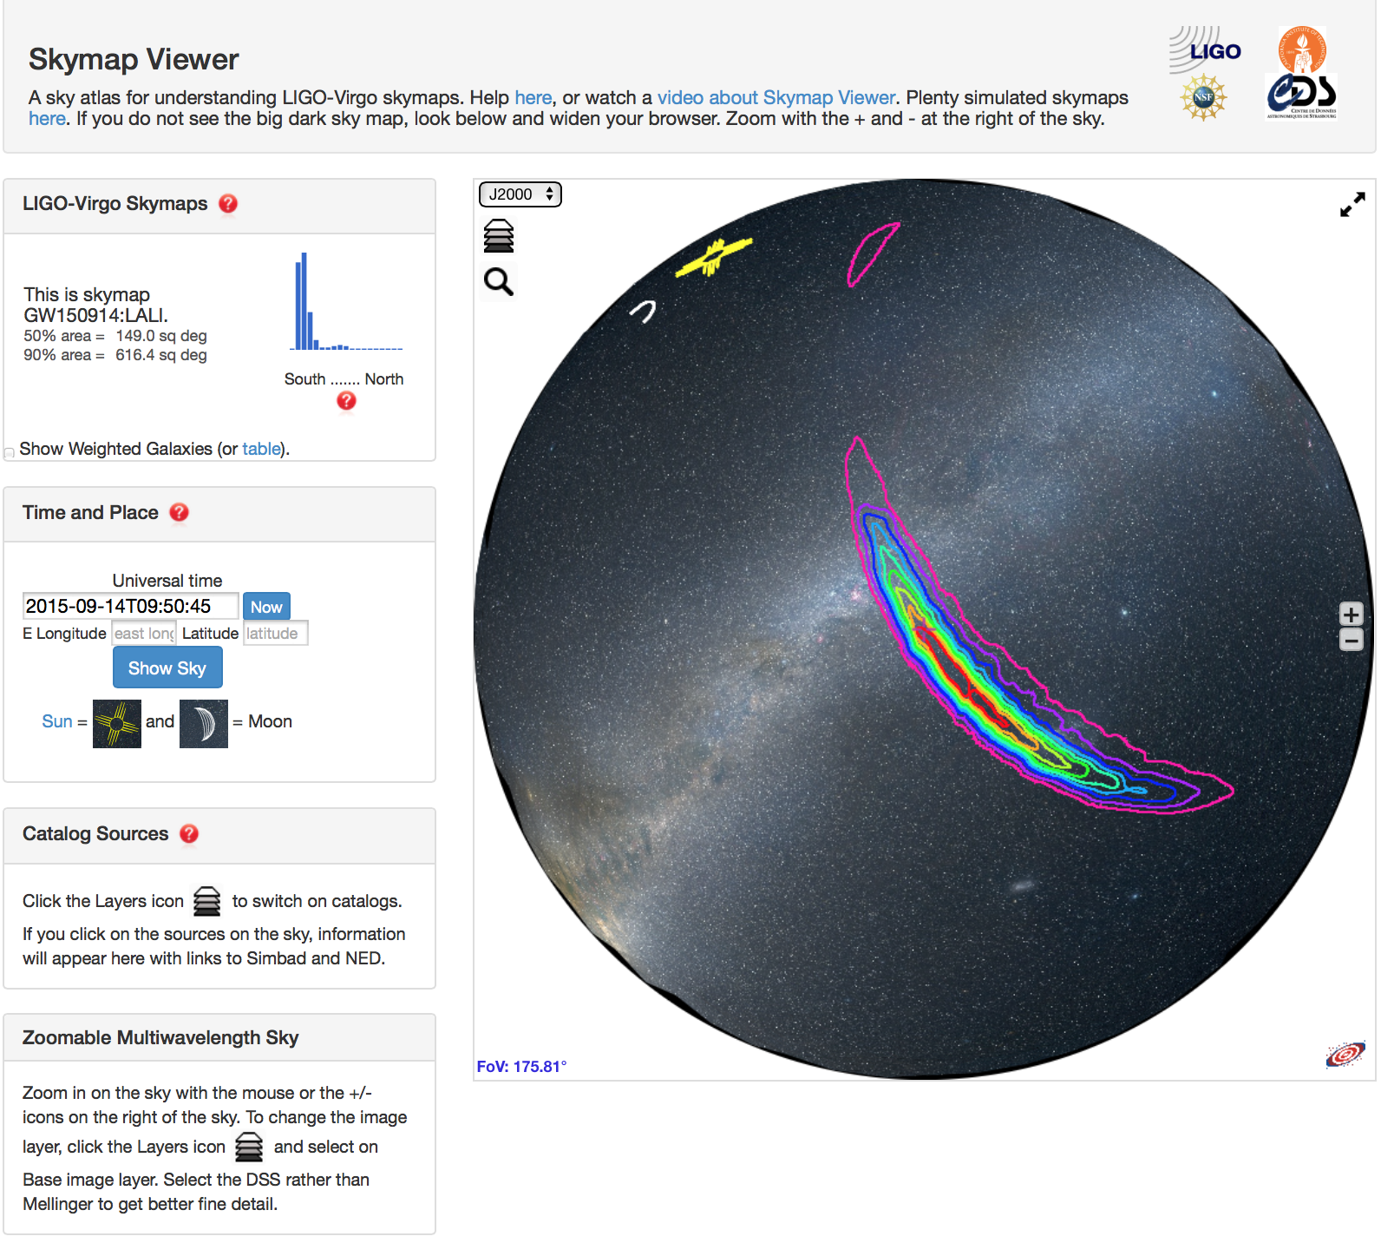
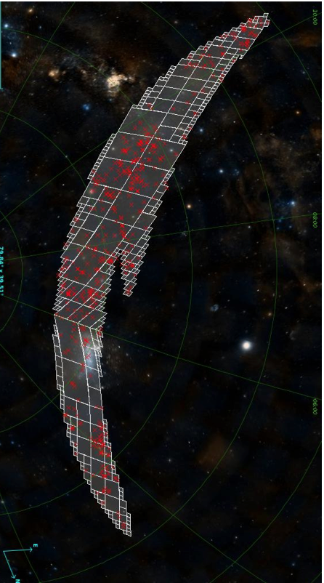
ASTERICS connections: gravitational waves
ASTERICS fostered use of VO for grav wave EM follow-up

Slide 15
connections & openness
connecting infrastructures: enhancing individual capabilities - necessary for science!
ICT: high speed data transport/timing
Embracing Open Science, Open Data
many challenges, many opportunities
Engage with society at large
Astro community+, education, public

Slide 16
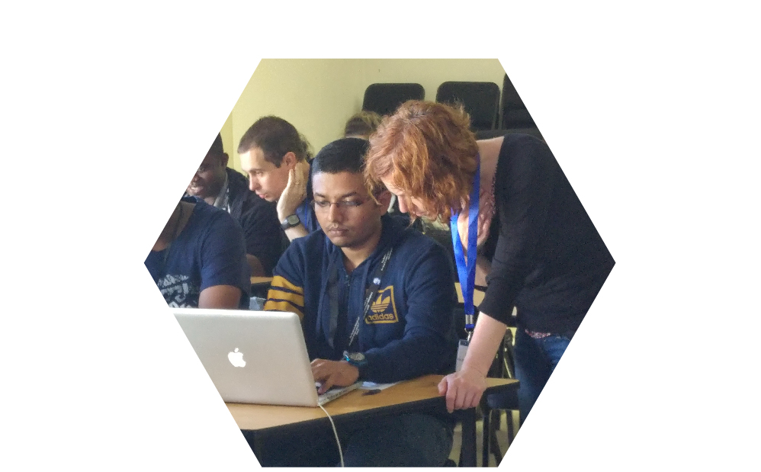
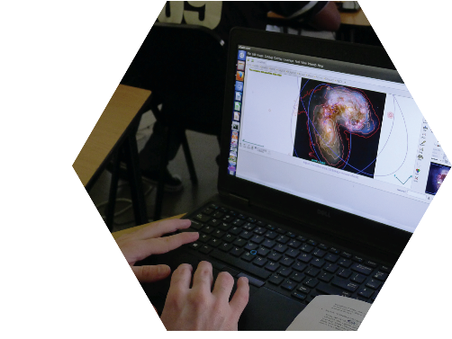
Strengths from connections
Enabling data science
Training and support
Skill sets for astronomy and the market place
Bonus outcomes: beyond Europe

Slide 17
multi-messenger timing and synchronisation
Building on success of e-VLBI
EXPReS, NEXPReS
…here comes the White Rabbit

Slide 18
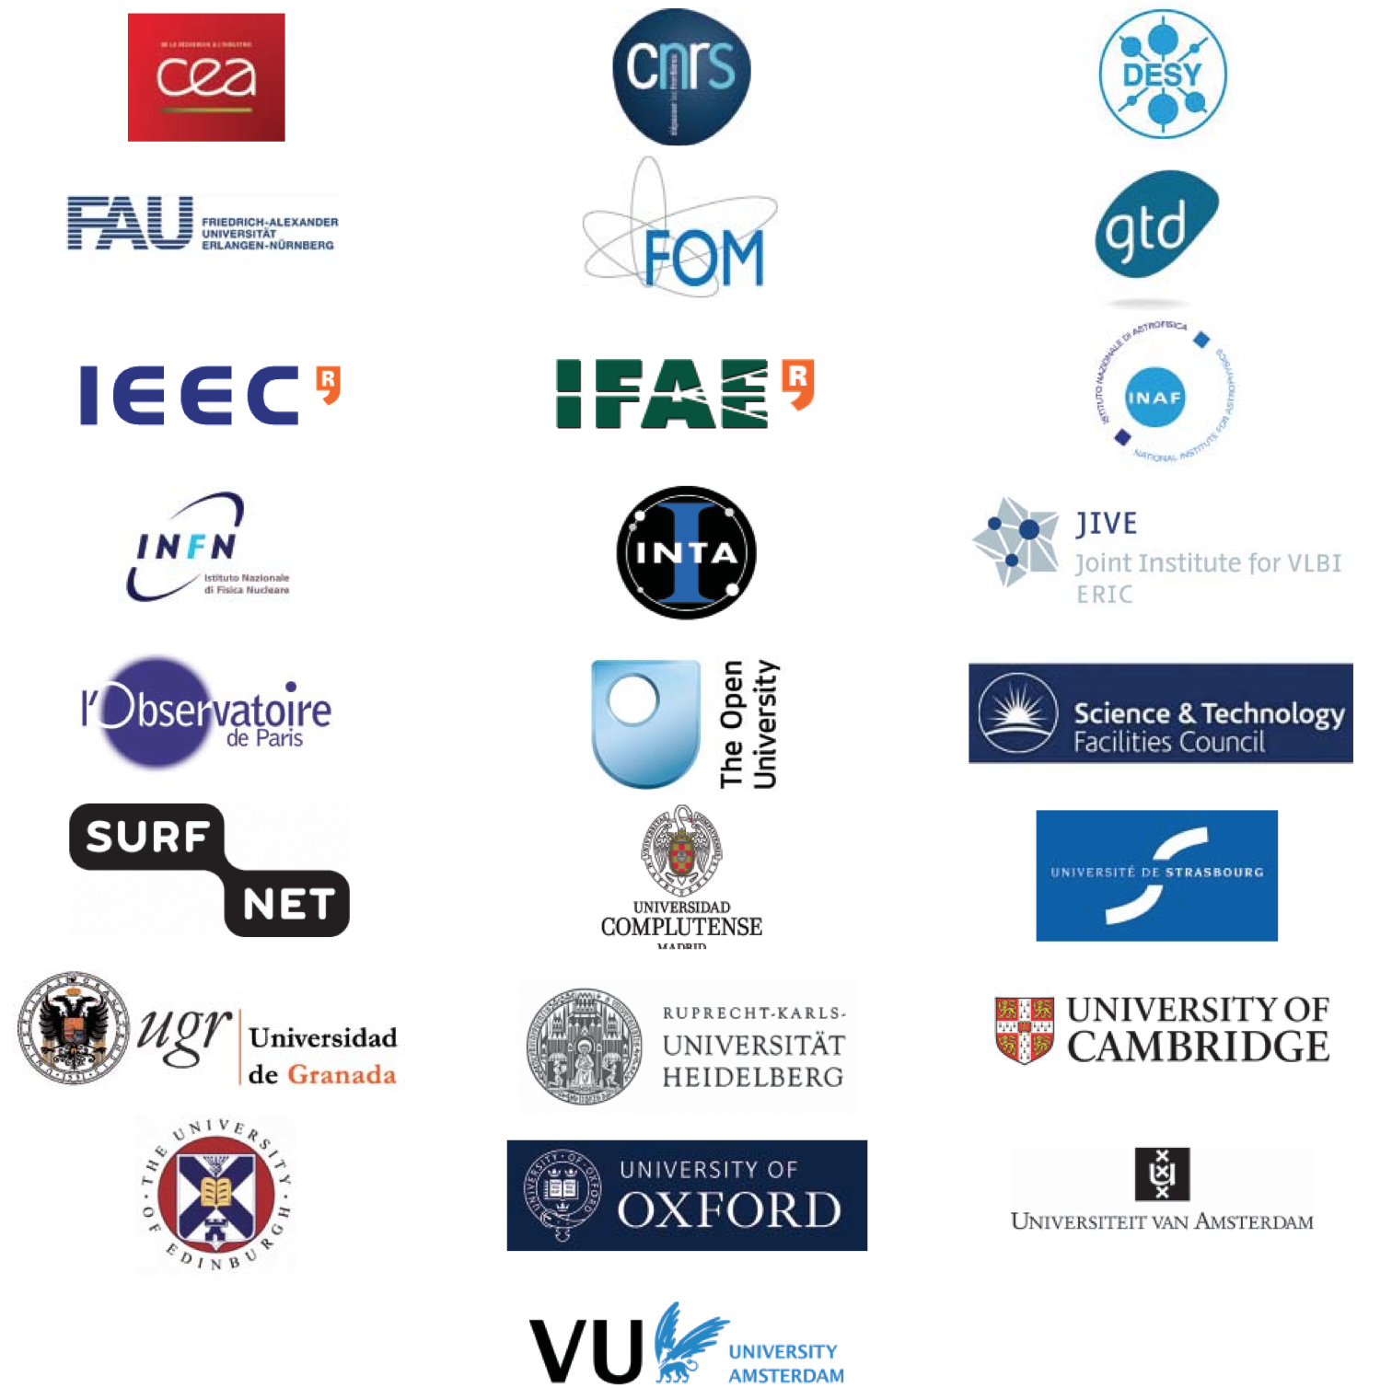
Participating institutions

Slide 19
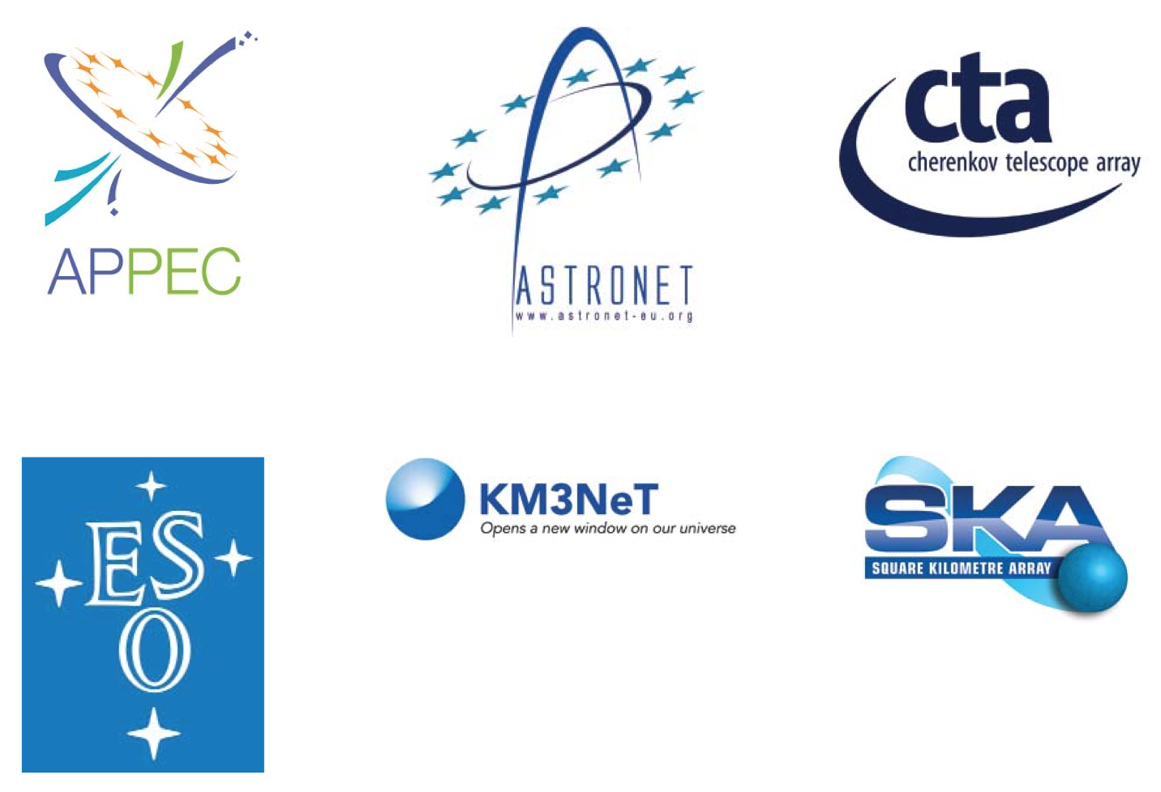
Supporting organisations and networks

