Slide 1
Dissemination, Engagement and Citizen Science
@stephenserjeant
Stephen Serjeant
ASTERICS Policy Forum
January 2018

Slide 2
DECS
Dissemination, Engagement and Citizen Science
Dissemination & public engagement
Open ESFRI facilities to wider stakeholders through citizen science (Open Science, or ‘Science 2.0’)
Audiences: scientific & technical communities, academia, private industry, other public research centres, SMEs, policy makers, general public
Coordinated citizen science experiments to open ESFRIs & pathfinders/precursors to public
Educational resources & efficacy metrics

Slide 3
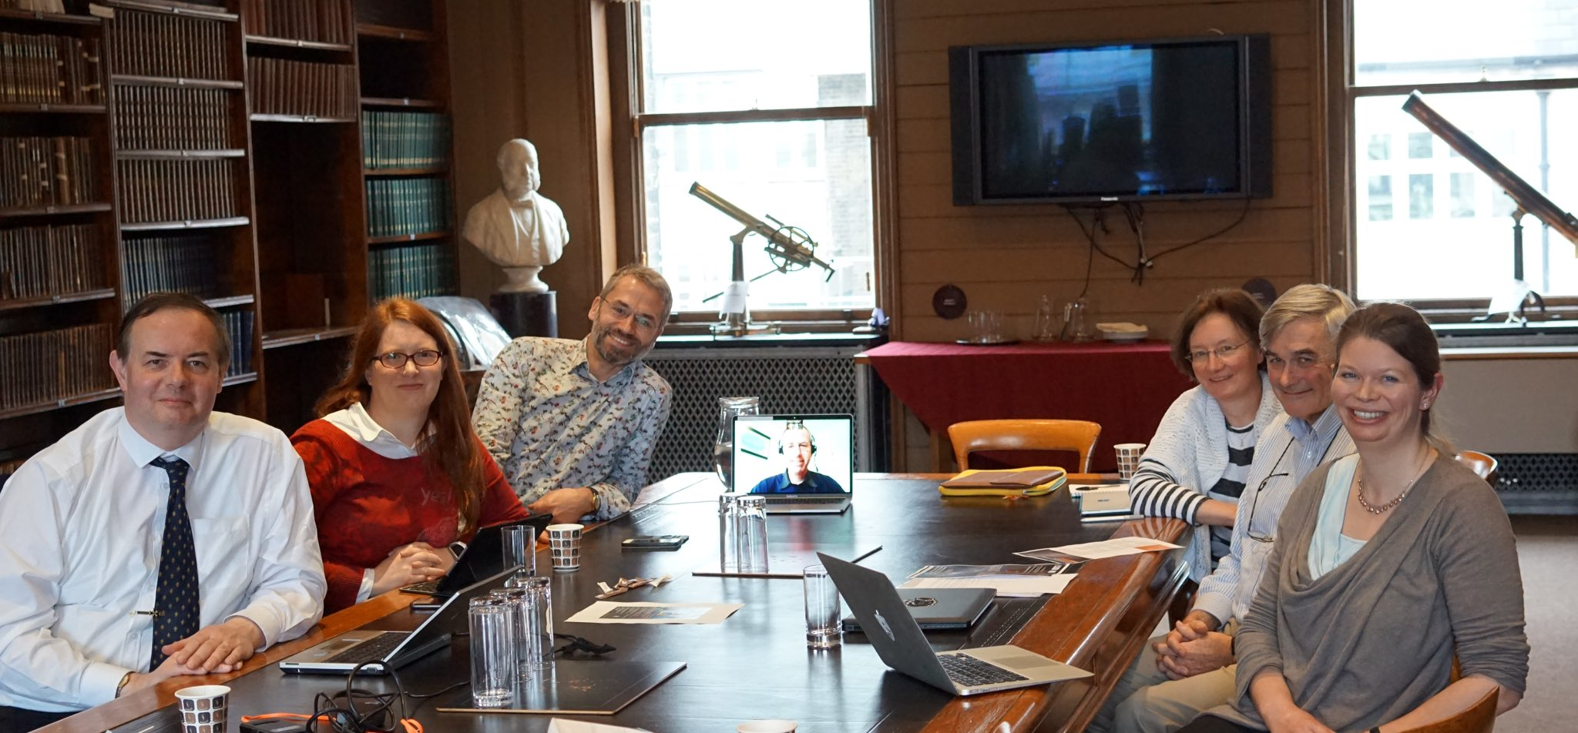
Dissemination, Engagement
Press release contacts and machinery
Website
Banners and brochure
Newsletters
Liaising with policy makers:
  input to EU Competitiveness Council, Nov 2015
  Written evidence to UK House of Lords Select Committee enquiry
  Aspiration to draft joint ASTERICS / OPTICON / EUROPLANET briefing notes on impact of space
Notes:
1) opticon does not do "space science" - people get confused by my
multiple hats
2) the UK goverment (BEIS/UKSA), the UK industry view, and the UKscience
community view is
strongly that we do NOT want the EC being involved in space science in
any way except as a paying customer. The highly political attempts by
the EC to take control of ESA would be a disaster for ESA's proven
system of excellent peer review. The impressive unanimity by the ESA
Council *the same government reps who are the EC* against EC takeovers
of ESA show that all ESA partners have the same strategic view.
My UK industry links show this is very strongly the view from all sectors.
So, while we are happy to work with Jo on dissemination at appropriate
fora, we certainly do not wish to be associated with the EC parliament
lobyying. Indeed, since in 2 years we will not be involved in the EC
parliament at all, while we will stil be #3 in ESA, it is hard to see any
basis for encouraging EC activity at all?

Slide 4
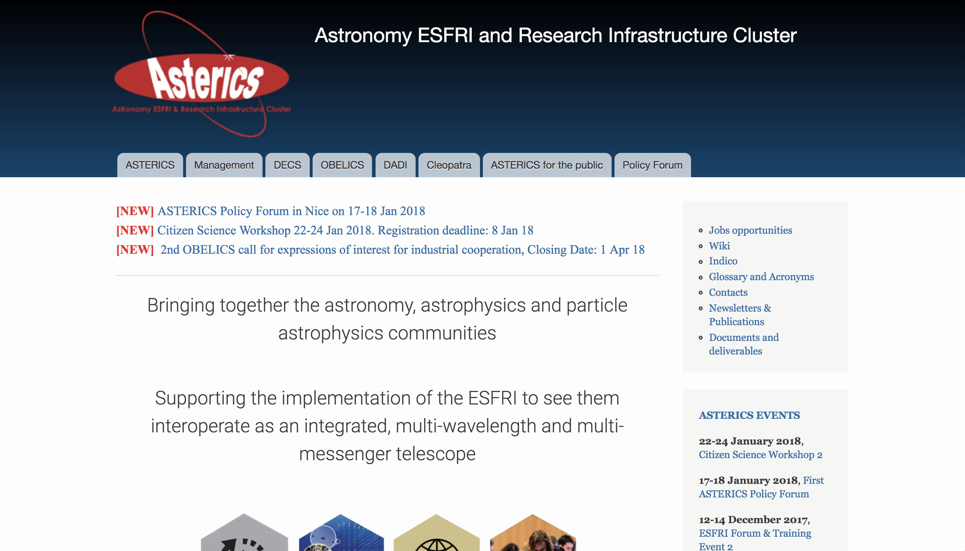
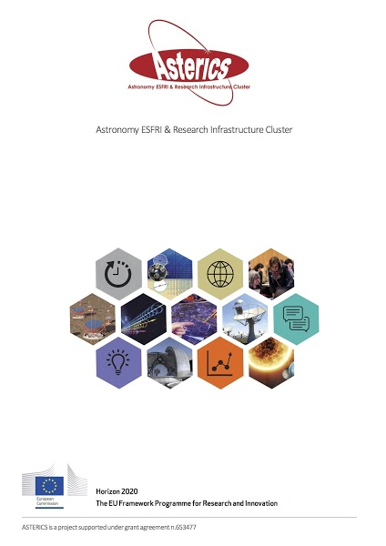
Dissemination, Engagement

Slide 5


Slide 6
Citizen Science
Citizen Science is not outreach!
http://oi-net.eu/
Notes:
The usual role of the outreach work package is just dissemination of information, but we want to do something far better. ASTERICS aims to use the best open science practice – not just in open access scientific publications and open access to data through the virtual observatory, but by direct engagement of the public in the process of what computer science people call ‘knowledge discovery’. We’re using citizen science, mass participation experiments. The important thing to remember is that citizen science is NOT outreach. It’s a tool for doing an experiment, like a spectrometer. You’re applying thousands or tens of thousands human brains on an algorithmically-complex classification problem.

Slide 7
The case for crowdsourcing
Slide from L. Forston

Slide 8
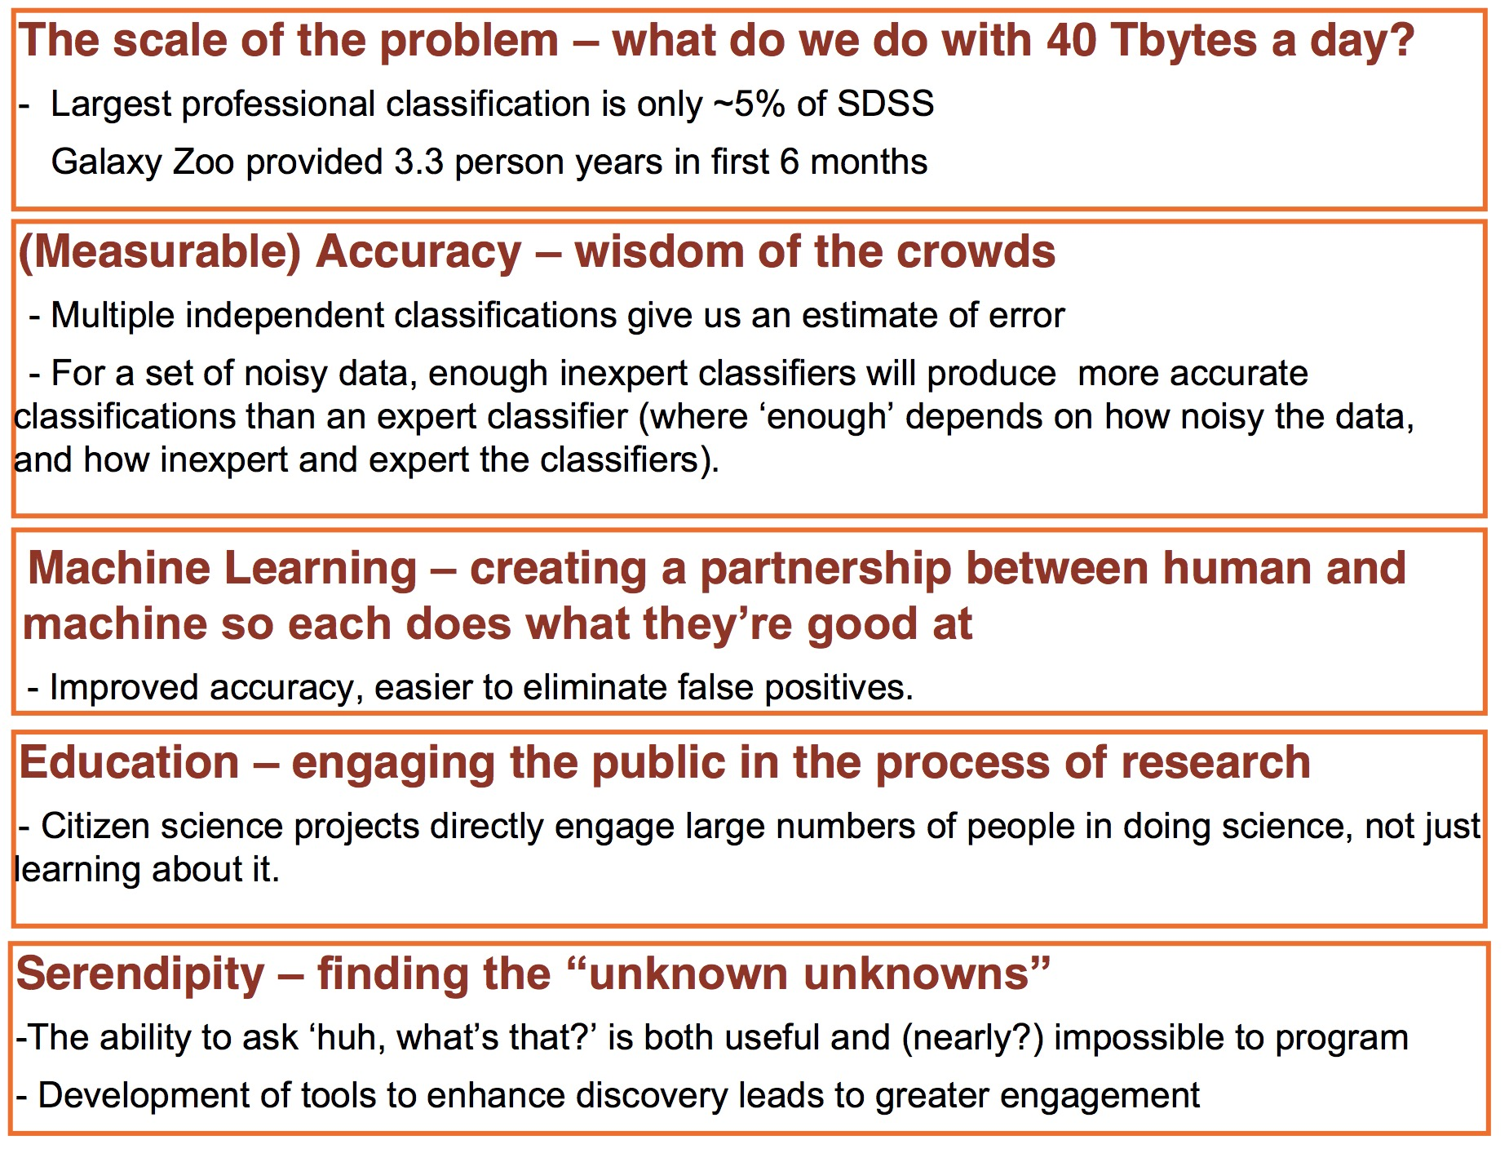
The case for crowdsourcing
Slide from L. Forston

Slide 9
NASA APOD

Slide 10
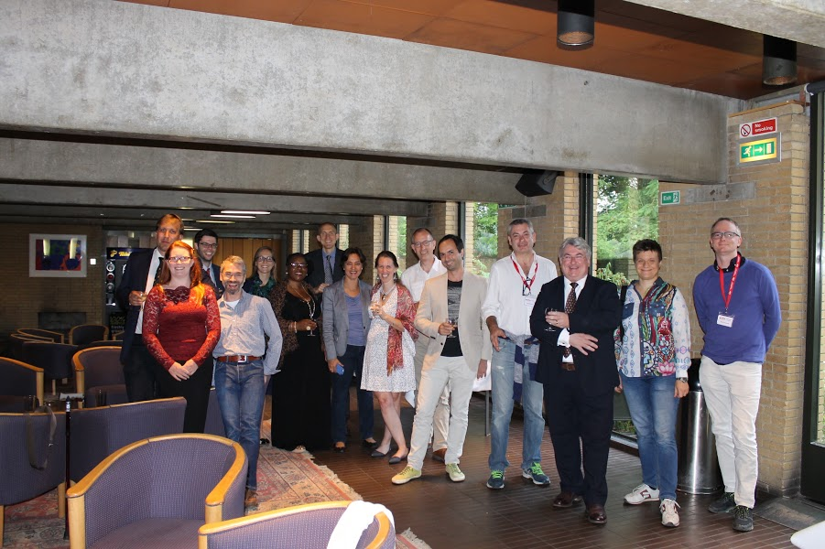
Citizen Science
Workshop 1: St Catherine’s College Oxford, July 2016
Representation from CTA, SKA, E-ELT, and other astronomy facilities
E-ELT not well suited to surveys that can be mined through crowdsourcing, but crowdsourcing can identify rare populations in survey data sets to supply E-ELT targets
Workshop 2: INAF Trieste next week!

Slide 11
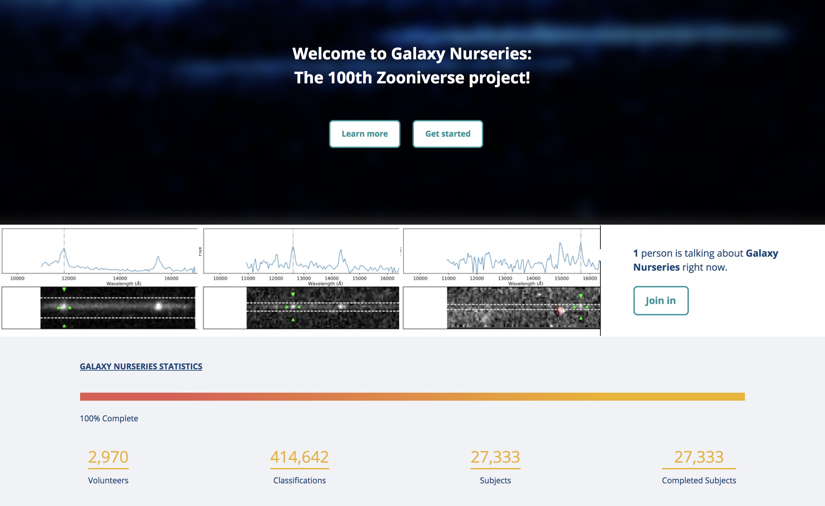
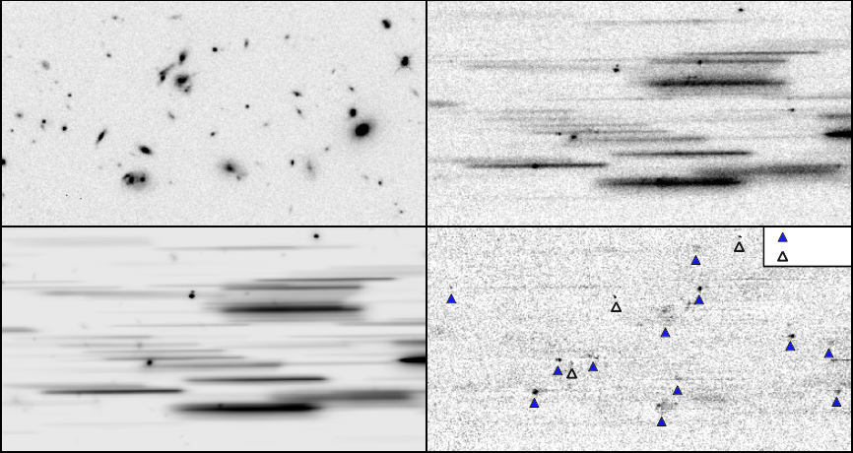
Deblending slitless spectra
Lead: Claudia Scarlatta
Science objective: a spectroscopic survey of star-forming galaxies and AGN, quantifying star formation rates and black hole accretion diagnostics
Activity: interactively deblend objects in confused slitless spectroscopy, for application on HST data (WISH) and future use in Euclid
3D-HST ApJS 2012
Notes:
CLAUDIA SCARLATTA NOT IN EU BUT WE ARE ‘OPEN’ IN GEOGRAPHICAL TERMS AND SHE DONATED HER TIME FOR THE POTENTIAL FUTURE BENEFIT OF THE ESA EUCLID MISSION

Slide 12
CREDO: Cosmic Ray Extremely Distributed Observatory
Lead: Piotr Homola https://credo.ifj.edu.pl/
Science objective: detect ultra-high-energy charged particles with a whole-Earth Cherenkov detector
Activity: use mobile phones as charged particle detectors, either while charging (so horizontal) or while playing Pokemon Go (so orientation known)
First CREDO meeting in August 2016: (47 registrants, 9 countries, 13 nationalities), quite good media coverage (TV, radio, daily press)
“Please feel free to convey my view of the importance of ASTERICS action in the case of CREDO: inspiration, practical know-how, valuable interpersonal exchange.”

Slide 13
Slide from Piotr Homola, CREDO inaugural workshop, August 2016

Slide 14
Slide from Piotr Homola, CREDO inaugural workshop, August 2016

Slide 15
Muon Hunters
Lead: Lucy Forston, CTA
Science goal: detect fainter Cherenkov events by visual classification
Activity: classify hadron vs. photon events in the CTA telescopes, morphologically and in the time domain; apply first to simulations and to e.g. HESS
Notes:
STRESS THAT LUCY INVITED AS CTA REPRESENTATIVE AND THAT EXPLICIT INTENTION IS TO BUILD EXPERIMENT THAT WORKS ON PATHFINDER DATA AND WILL BE APPLIED LATER ON FULL ESFRI DATA

Slide 16
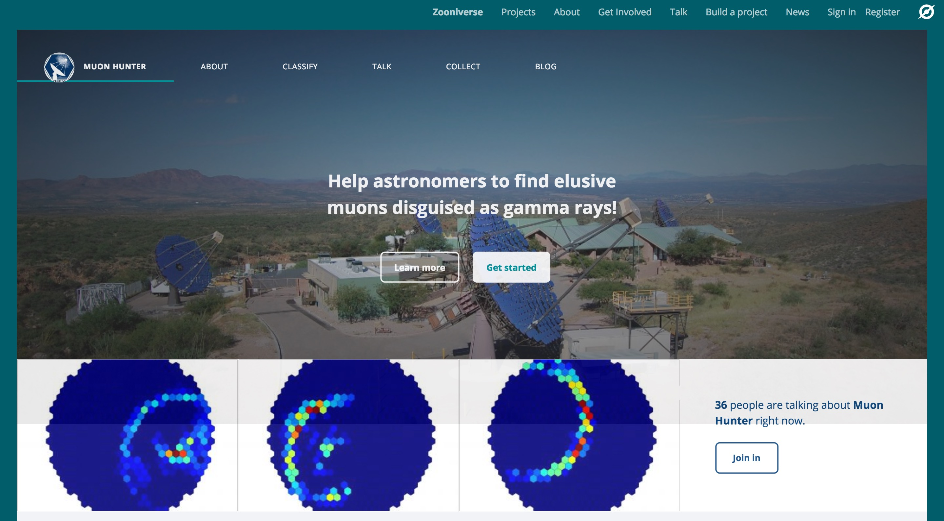
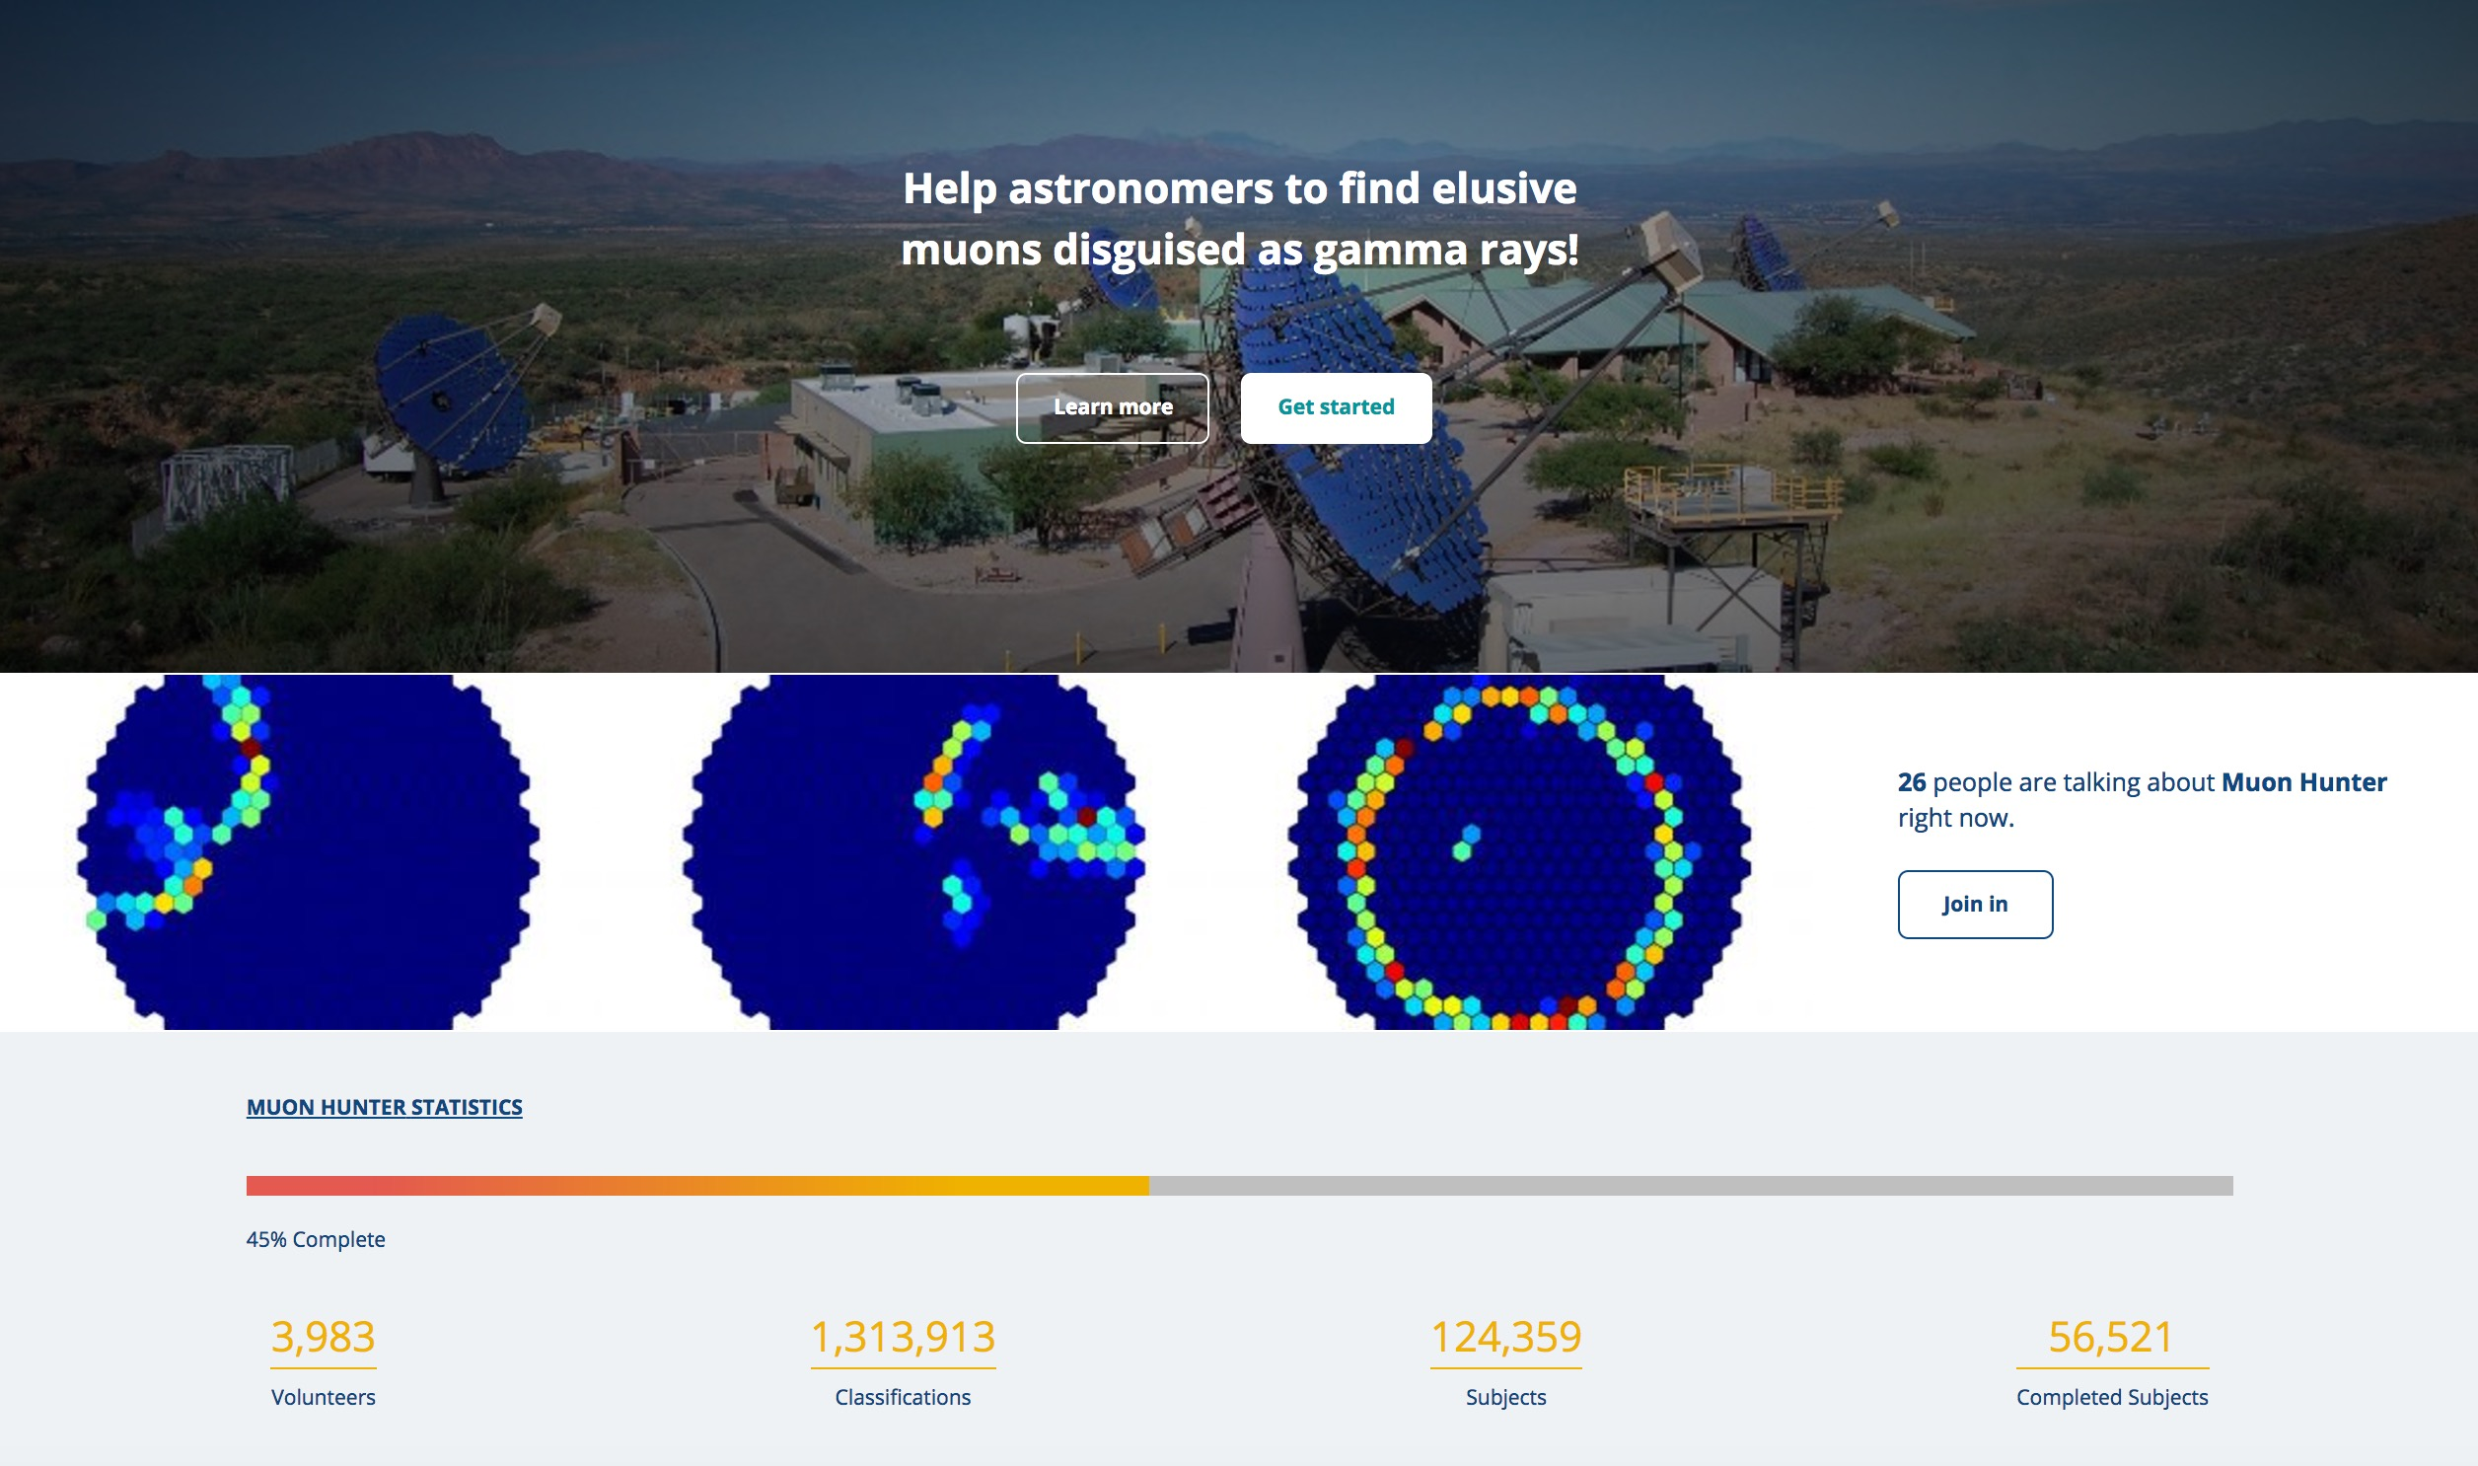
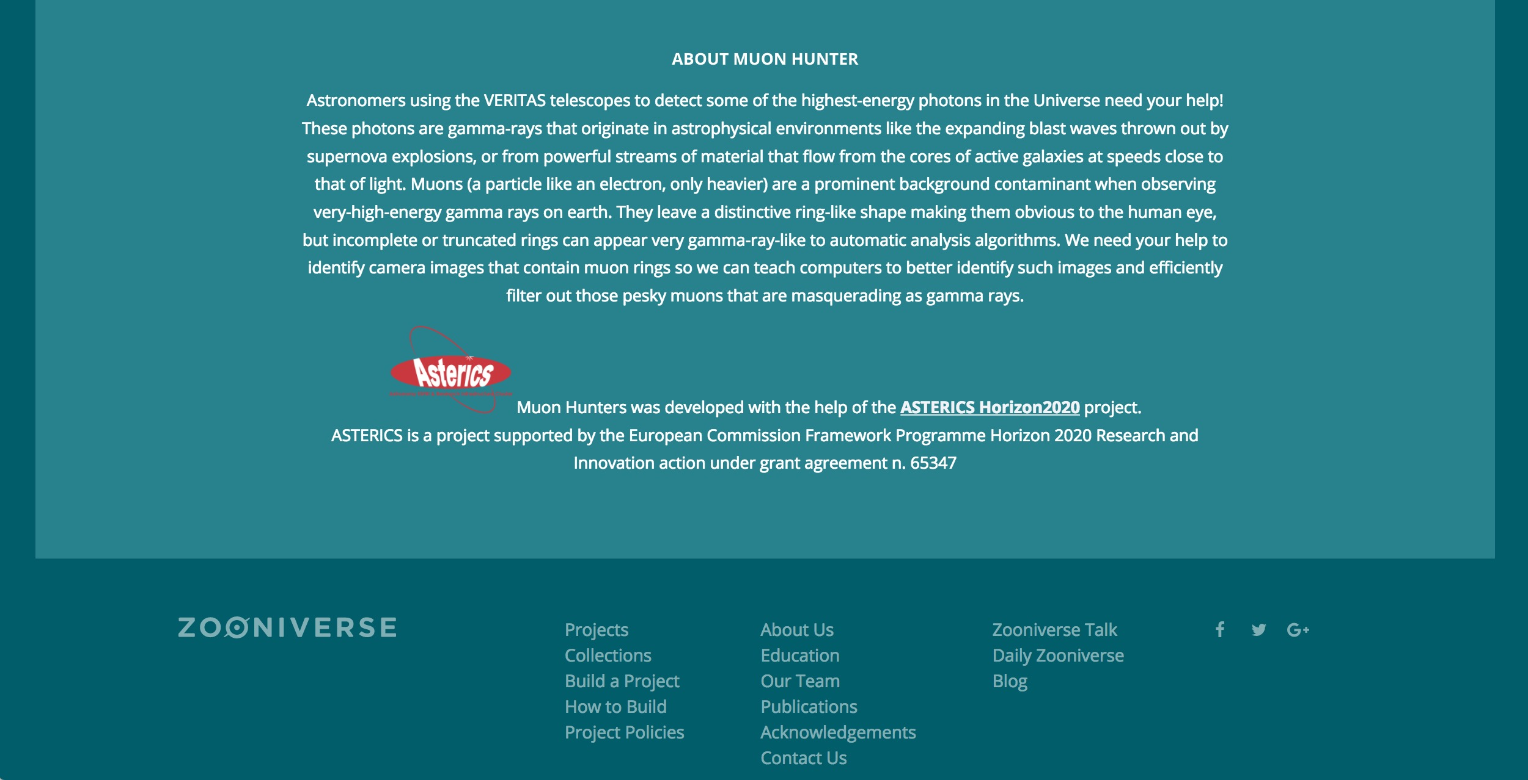
1.3 million classifications in the first five days!

Slide 17
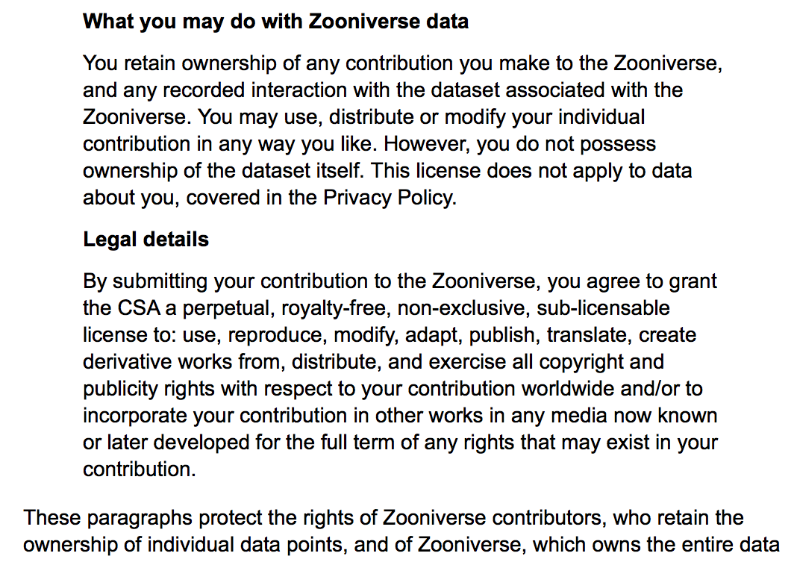
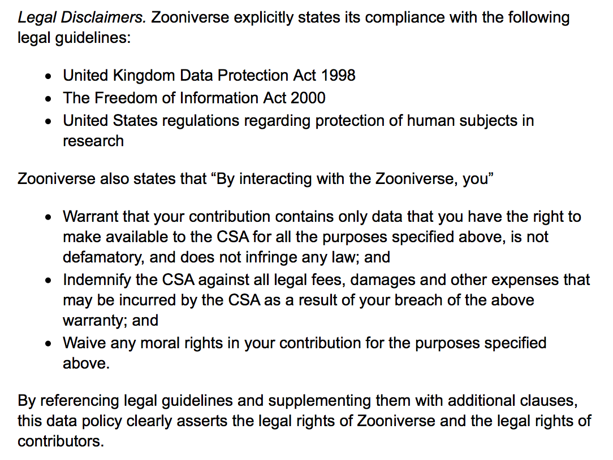
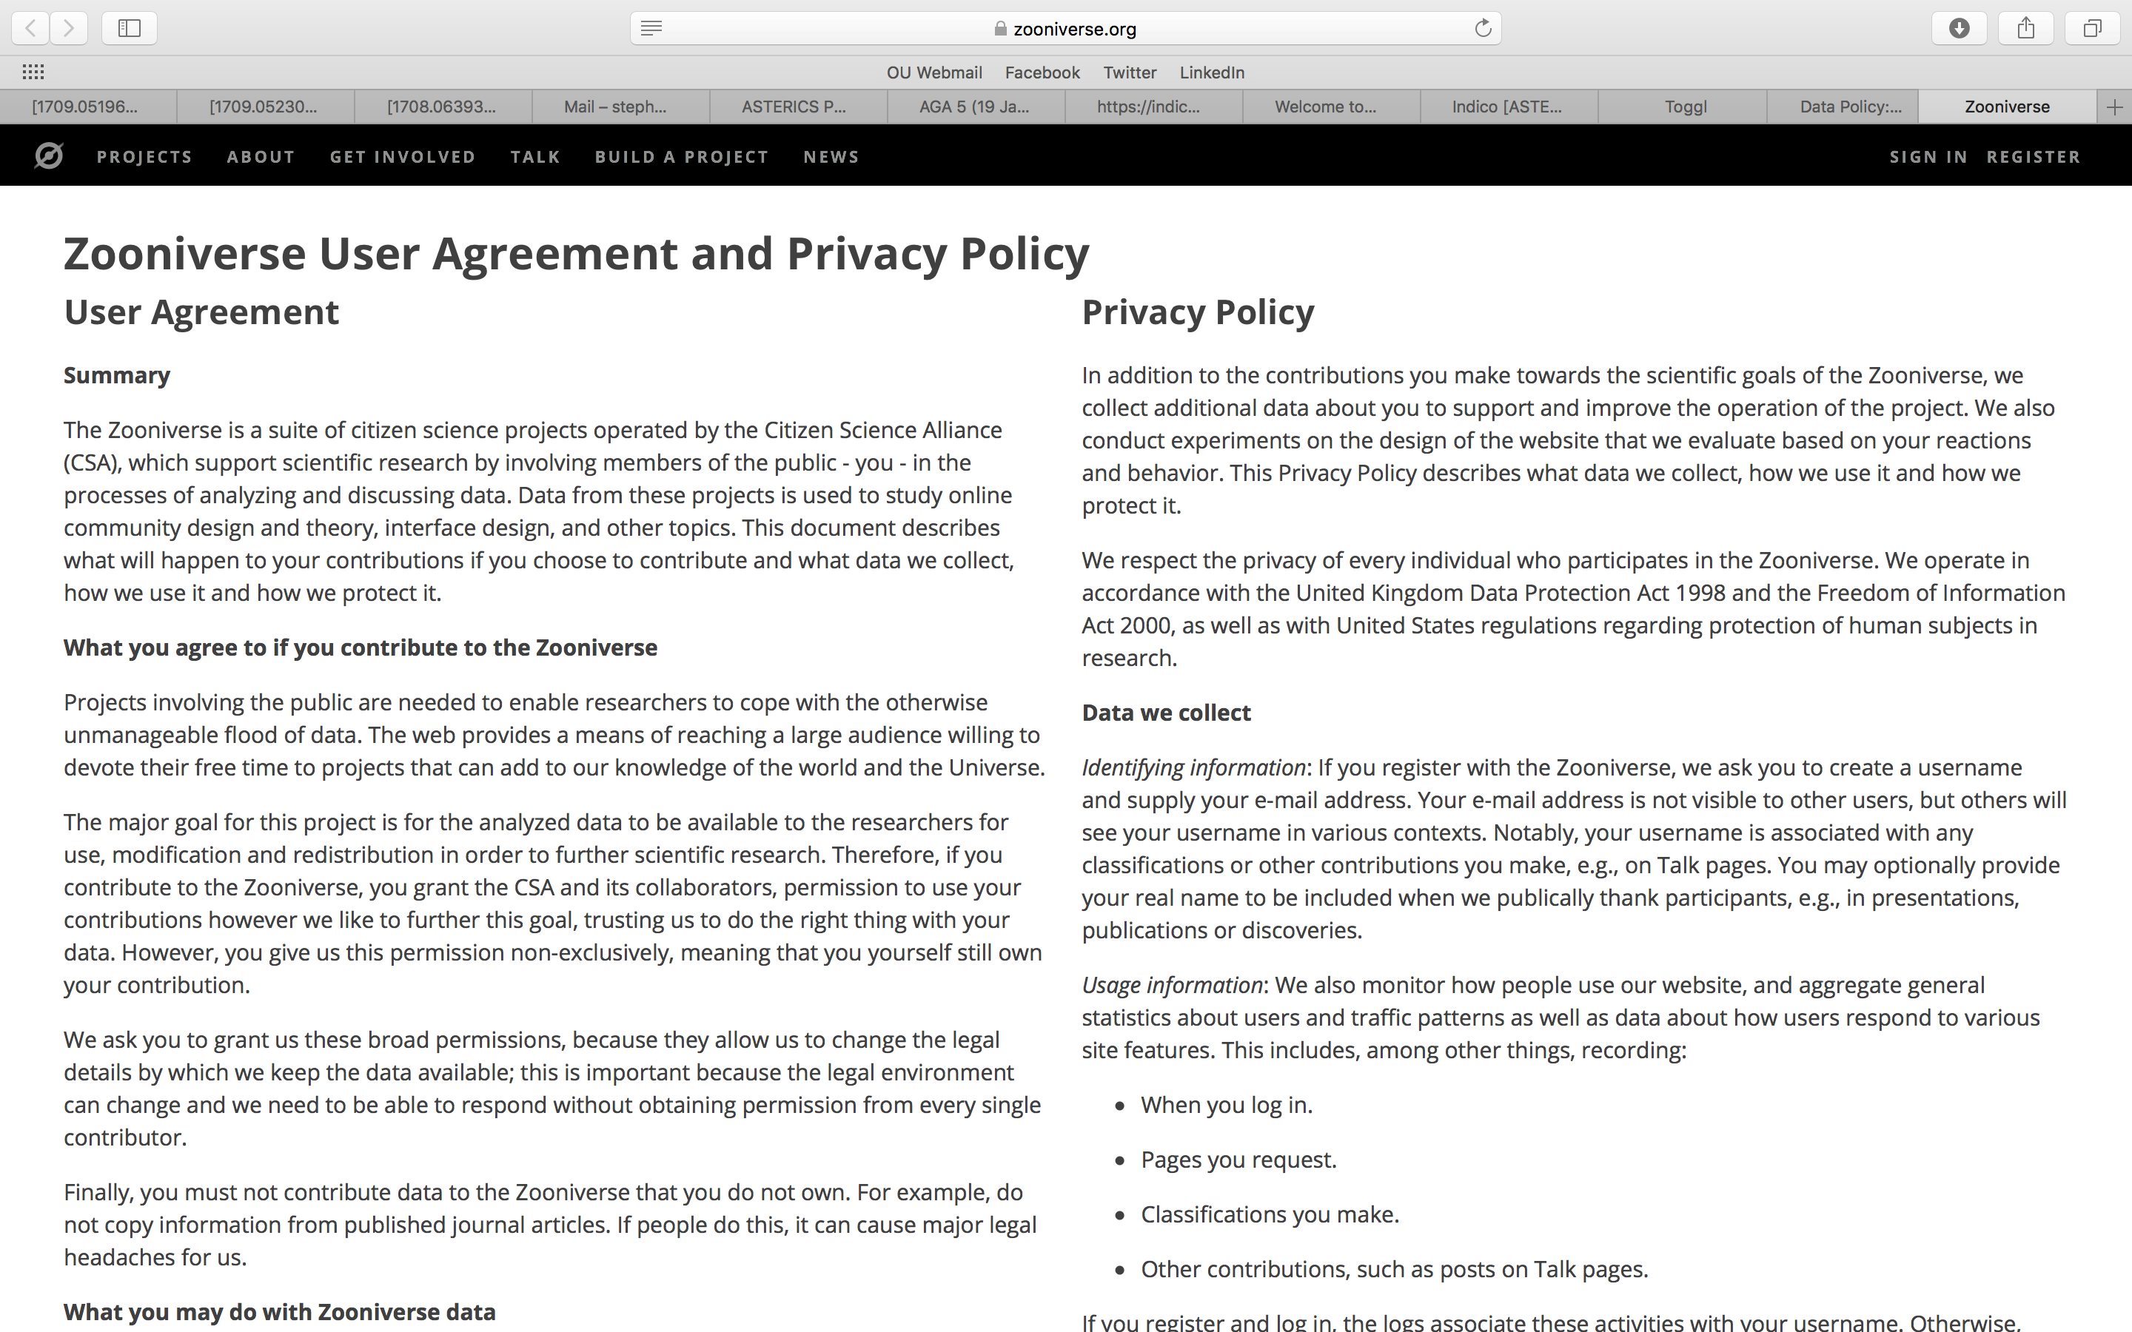
Policy areas to consider
Zooniverse: data must be in public domain
All crowdsourced data public after 12 months
How can multi-messenger campaigns involve the non-professional community?
How should non-professional contributors be credited in publications etc?
How should targets of opportunity be provided – managed, or just thrown over the fence?

Slide 18
One final closing thought on dissemination:
Should we publish these multi-messenger / multi-wavelength use cases and policy recommendations?

Slide 19
